Slide 1
Coronary Artery Stenosis Detection
Arman Ibrayeva

Slide 2
1. Advancements and Challenges in Automation of Coronary Artery Stenosis Detection
Arman Ibrayeva
5 June, 2025

Slide 3
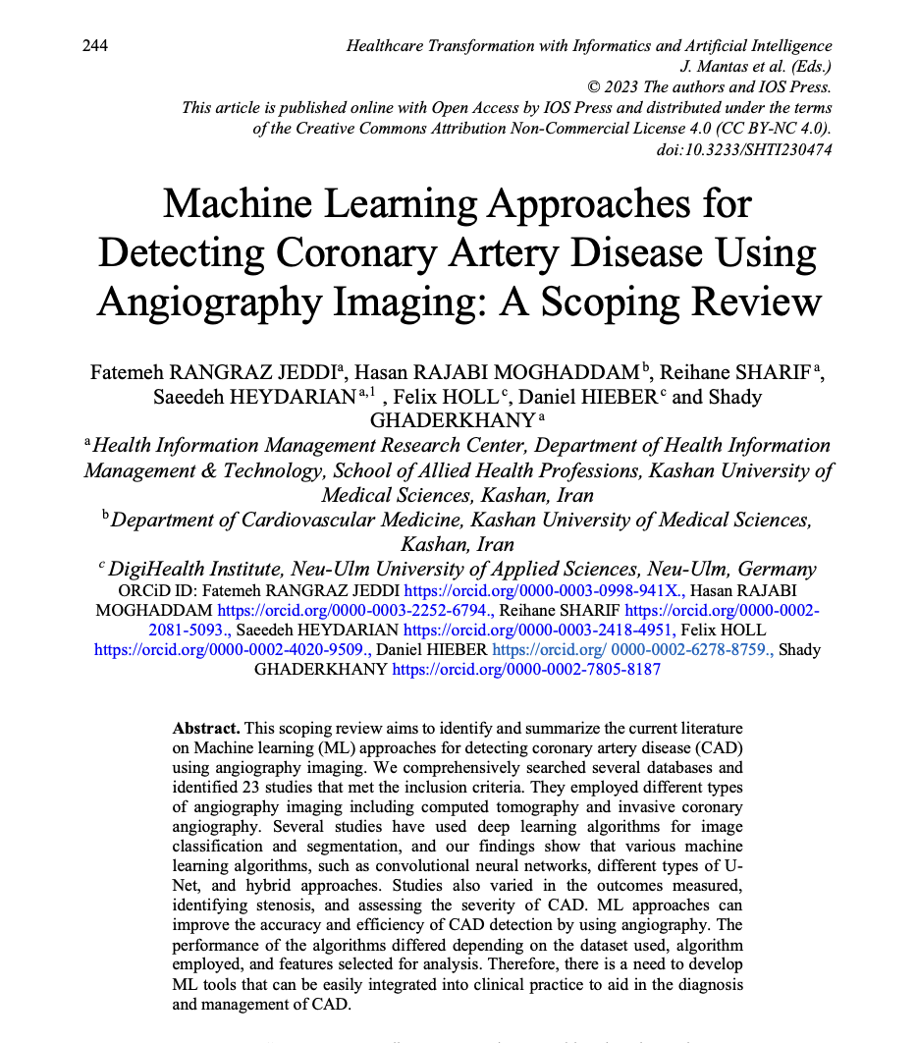
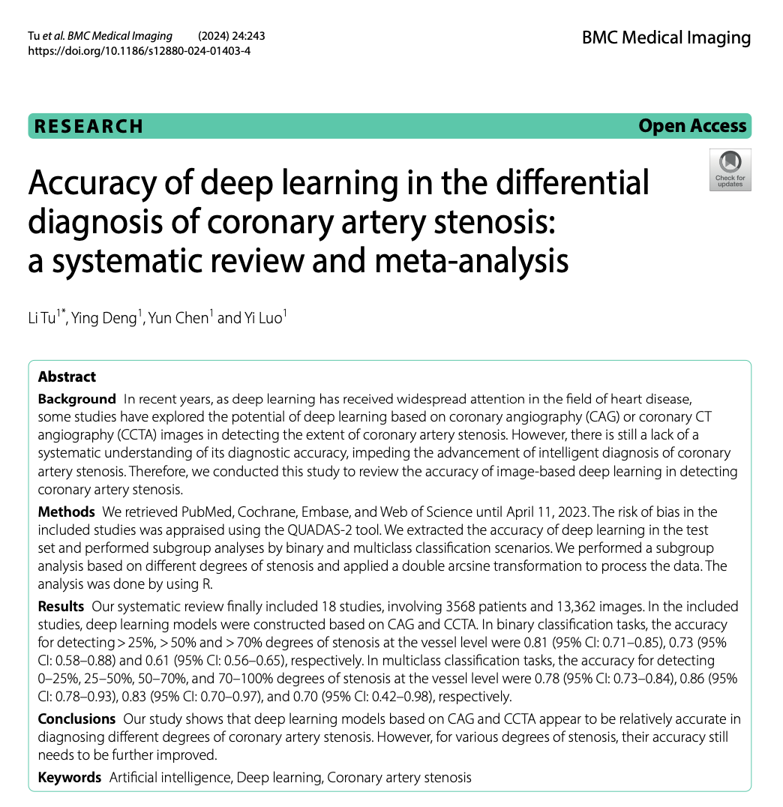

Slide 4



Slide 5
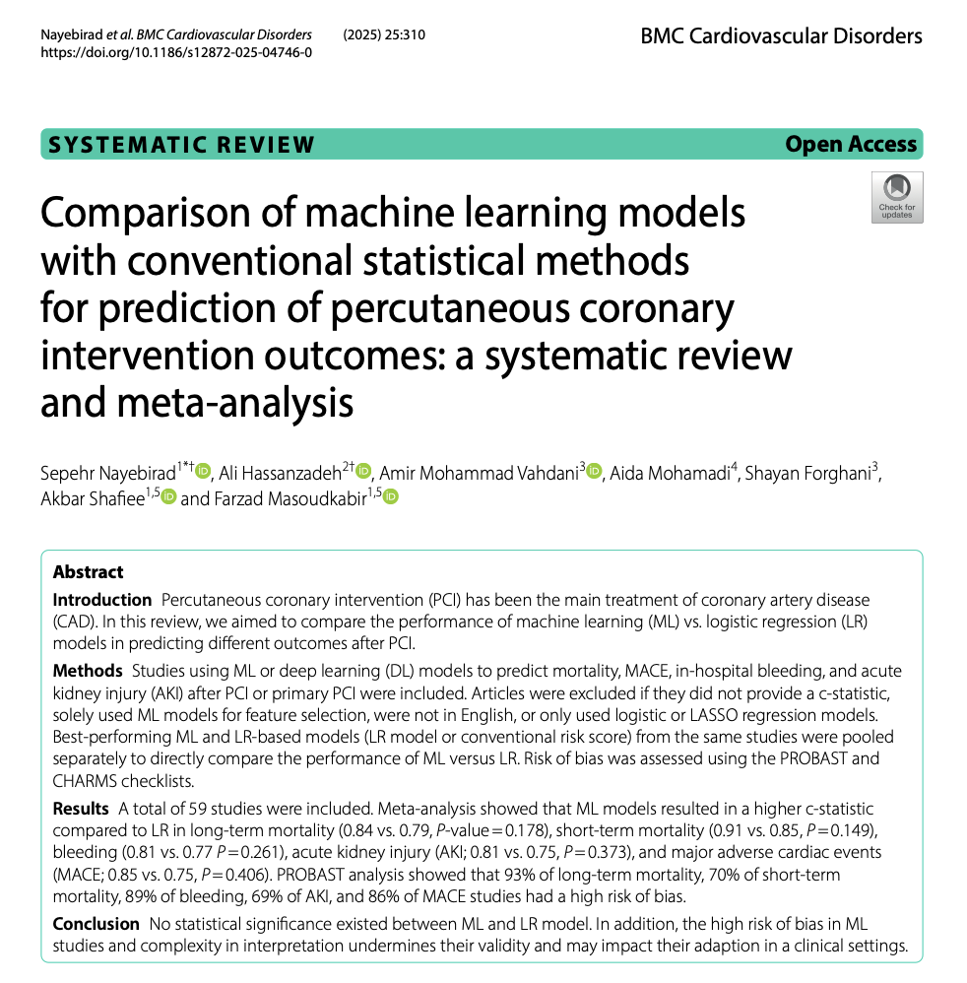
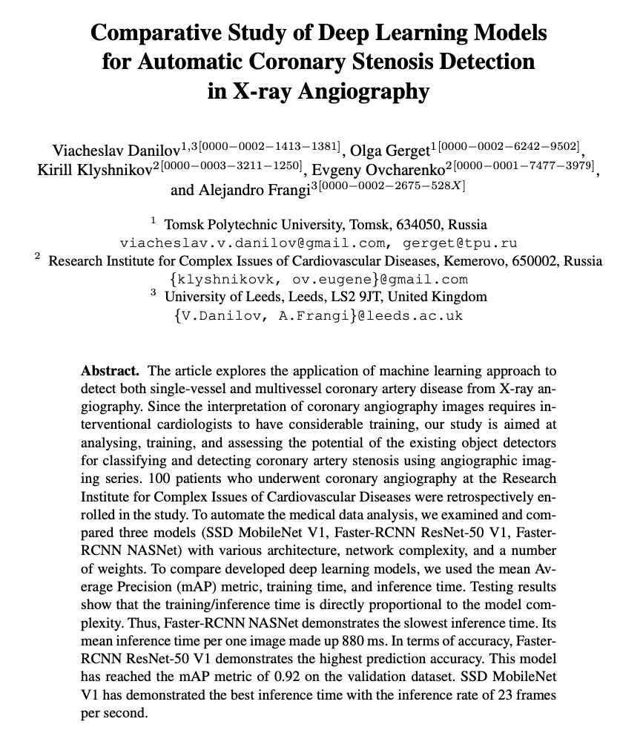

Slide 6
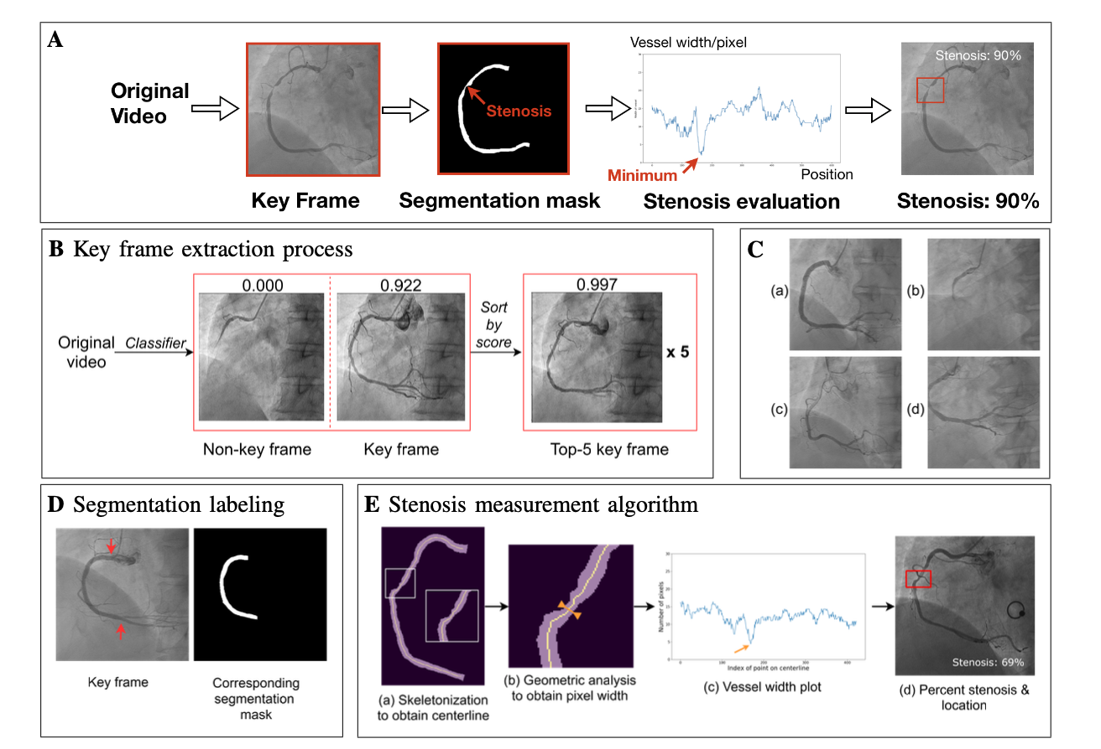
Overall Performance Trends Across Stenosis Severity
Multiclass classification (vessel-level accuracy):
0–25% stenosis: 78% accuracy
25–50% stenosis: 86% accuracy
50–70% stenosis: 83% accuracy
70–100% stenosis: 70% accuracy
Binary classification (vessel-level accuracy):
25% stenosis: 81% accuracy
50% stenosis: 73% accuracy
70% stenosis: 61% accuracy

Slide 7
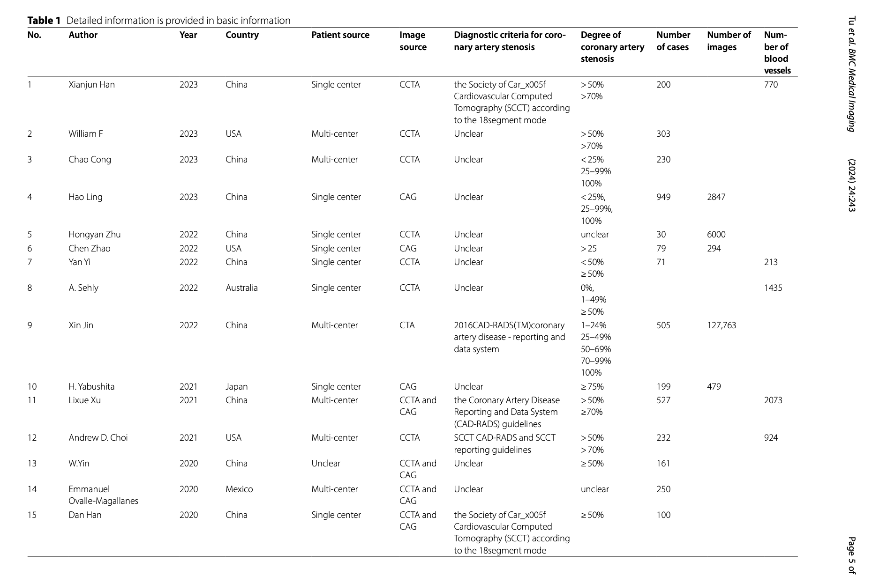
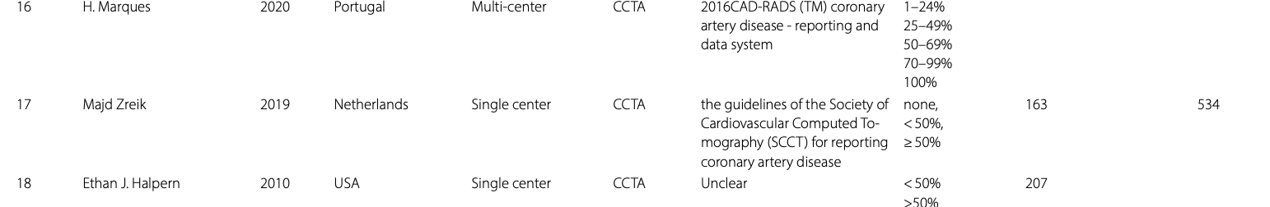
Features from existing research

Slide 8
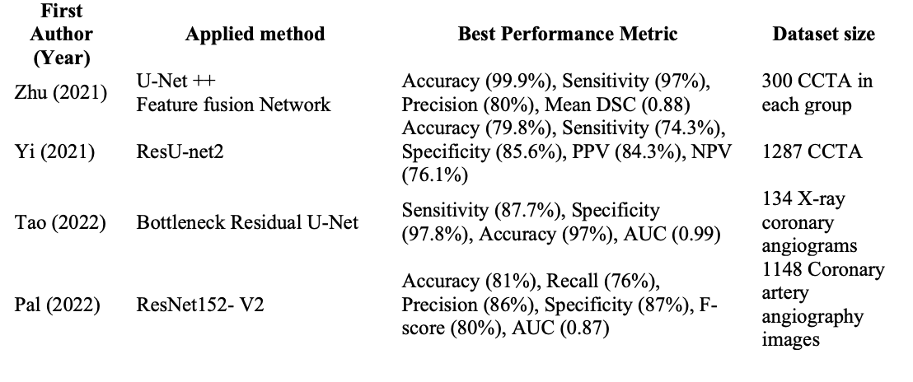
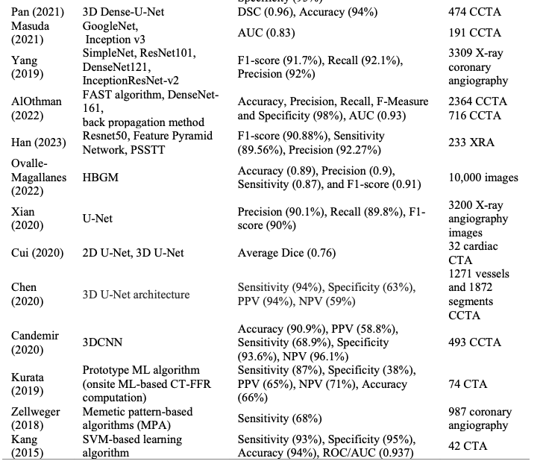
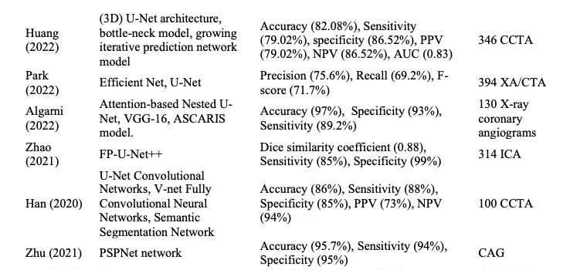
Features from existing research

Slide 9
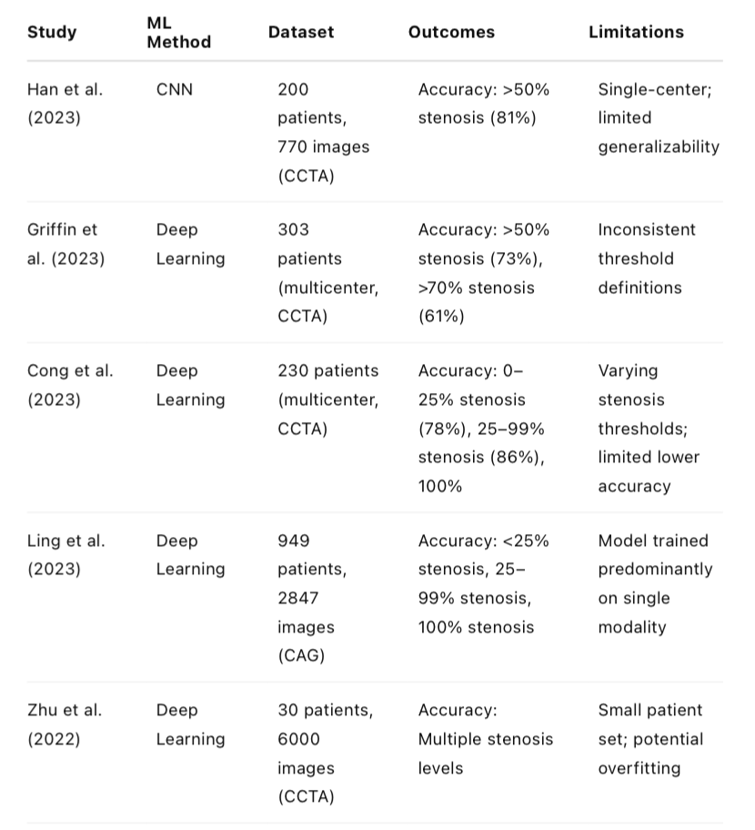
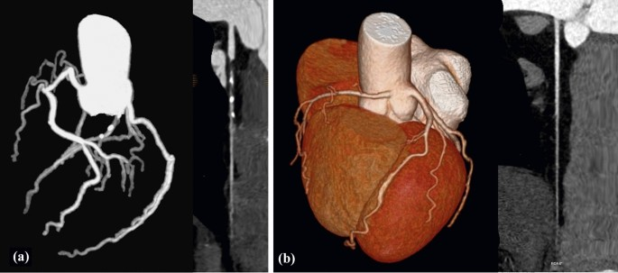
Features from existing research

Slide 10
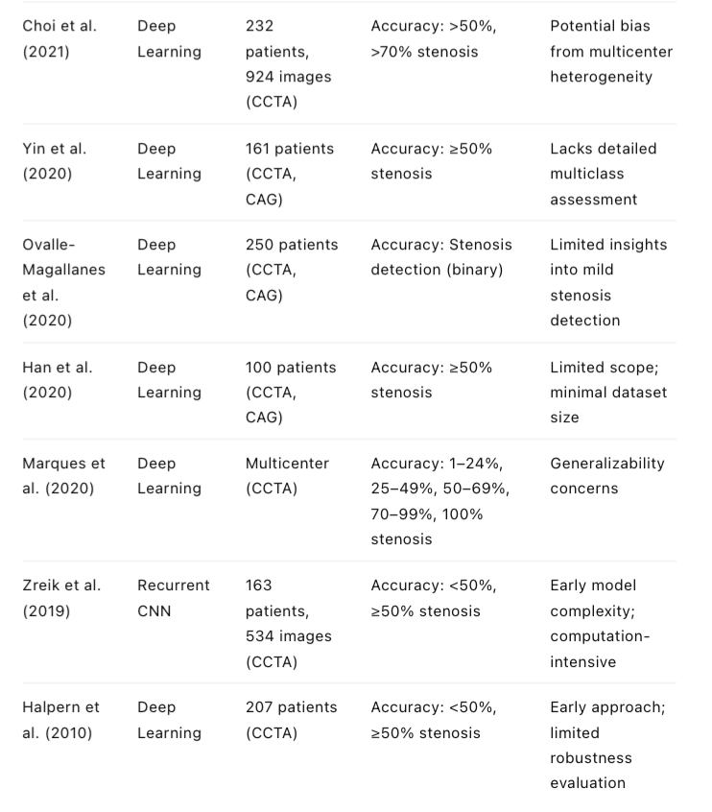
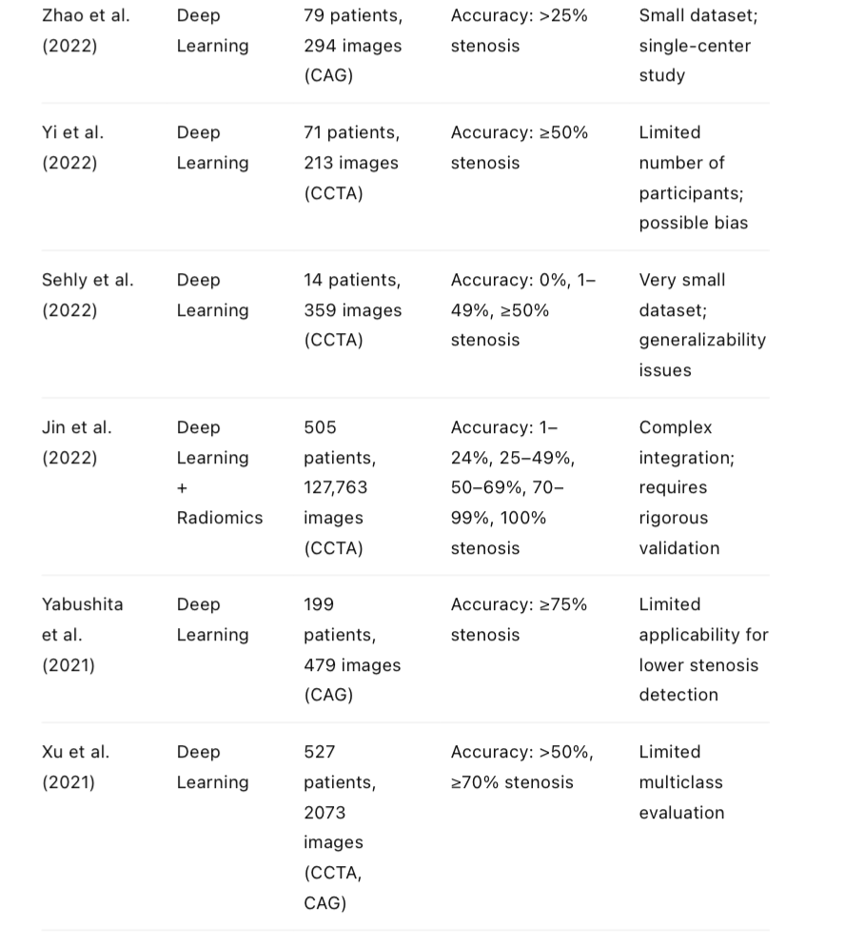

Slide 11
Challenges
The development of AI across different imaging modalities presents certain difficulties (e.g. Snigdha Mohanty et al. cross-imaging modalities, such as MRI, CT, and 3D rotational angiography.
Even within the same modality, the impact of noise during the image segmentation process remains a serious challenge in practical applications.
The speed of segmentation during the process is also a challenge, and some researchers have been exploring solutions to improve running speed.
Additionally, in manual segmentation, the reproducibility of results remains a significant challenge due to the reliance on the prior knowledge of human experts.
The models were mainly built on both CCTA and CAG images and seldom on CAG images.

Slide 12
Main gaps
Accuracy at Lower Stenosis Thresholds:
Accuracy significantly declines at lower thresholds (e.g., below 50%). This limitation can hinder early detection and proactive intervention in less severe but clinically relevant cases.
Limited Dataset Variability:
Many studies were single-center, potentially limiting model generalizability. Multicenter, diverse datasets remain under-explored, leaving questions about how models generalize across different patient populations and imaging modalities.
Model Validation and Bias Risks:
Potential biases exist in patient selection, index test interpretation, and reference standard assessments due to unclear reporting practices, which could affect model reliability.
Limited Application to Dynamic Imaging:
Most current research focuses on static images (single frames from CAG or CCTA). Limited exploration has been made of models trained explicitly on dynamic (video) angiography, which might offer richer temporal data for analysis

Slide 13
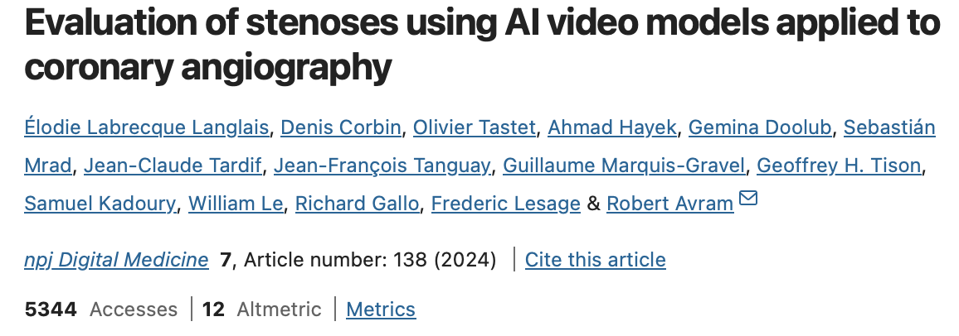
Video-based models
DeepCoro, an advanced AI system designed for video-based analysis of CAG to evaluate coronary artery stenoses. DeepCoro employs a pipeline of six algorithms to register, segment, assign coronary artery segments, and predict stenosis percentages, leveraging the temporal dimensions of CAG videos to mimic cardiologists’ assessments. The system enhances prior work (e.g., CathAI) with innovations in vessel tracking and segmentation, achieving performance closer to expert cardiologists. The study used a large dataset and multiple validation sets, demonstrating significant improvements in accuracy.
DeepCoro: A Video-Based AI Pipeline
Study: Introduced a video-based Swin3D model integrated with vessel tracking for CAD analysis.nature.com
Dataset: Utilized 182,418 CAG videos spanning 5 years.nature.com
Results:
Achieved a classification AUROC of 0.8294.
Demonstrated lower variability in stenosis assessment compared to expert cardiologists.
Reference: nature.com

Slide 14
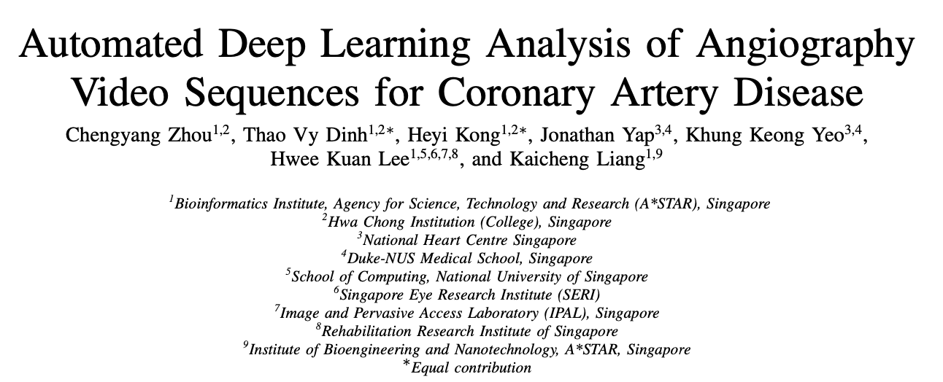
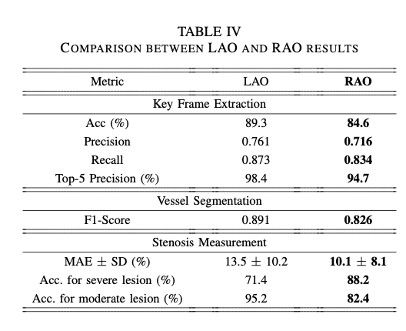
Video-based models
Study: Developed a three-stage pipeline comprising key frame extraction, vessel segmentation, and stenosis measurement using ResNet and U-Net architectures.researchgate.net+1arxiv.org+1
Dataset: Anonymized angiograms from a tertiary cardiac institution.frontiersin.org+8researchgate.net+8arxiv.org+8
Results:
Achieved a key frame extraction top-5 precision of 98.4%.
Obtained a vessel segmentation F1-Score of 0.891.
Reported a stenosis measurement Type I Error rate of 20.7%.
Future directions:
The extension to the RAO view provides inspiration for further research. Future work include expansion to more views such as the anterior-posterior (AP) Cranial view to visualize the more distal vessel segments. Lever- aging information from individual views and combining them in an optimal way will improve our model’s accu- racy. The ability to integrate information from multiple views will be even more critical as we continue work on the left coronary artery, which has a more complex vessel architecture studied from up to 6 view projections.

Slide 15
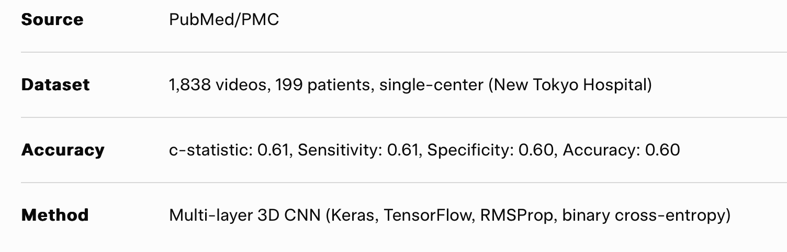
Video-based models
Development of Novel AI for Coronary Stenosis Detection (2020)
Journal of Atherosclerosis and Thrombosis

Slide 16
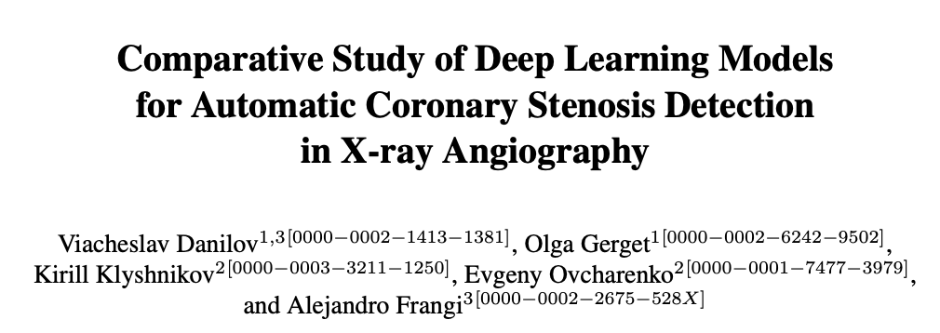
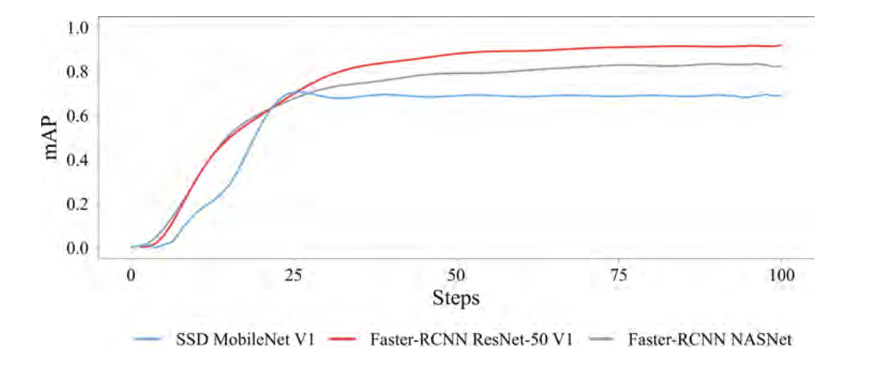
Small (area < 322), medium (322 ≤ area ≤ 962), and large (area > 962) objects. A total of 2509 small objects (30%), 5704 medium objects (69%), and 111 large objects (1%) were obtained in the input data.
We trained three well-known and promising detectors based on different neural net- work architectures (MobileNet, ResNet-50, NASNet) to locate the single-vessel dis- ease. Faster-RCNN ResNet-50 V1 has an optimal accuracy-to-speed ratio.
Average Precision (mAP@0.5 metric) of 0.92 at 10 frames per second. The fastest and relatively lightweight SSD MobileNet V1 model has the mean Average Precision of 0.70 at 23 frames per second.

Slide 17
Other Applications
Neural network-based models have been effectively employed to predict drug permeability across the placenta.
Machine learning approaches, integrating fingerprint amalgamation and data balancing, have been used to comprehensively analyze drug permeability through the blood-brain barrier.
Additionally, deep learning methods have been applied to estimate age and gender from electro-cardiogram signals

Slide 18
Deep Learning for Medical Image Segmentation
Efficient CNN models such as ConvUNeXt and DRU-Net have been developed for precise medical image segmentation, including ultrasound image segmentation.
Improved neural networks have been designed for liver CT and liver ultrasound image segmentation.
A novel framework named Cotr effectively combines CNNs and transformers for accurate 3D medical image segmentation.
In liver tumor diseases, image segmentation is critical for:
Diagnosis,
Staging,
Treatment planning,
Surgical interventions,
Impacting diagnostic and therapeutic outcomes.
Research has explored:
Risk assessment of computer-aided diagnostic software for hepatic resection.
Effectiveness of fusion imaging for immediate post-ablation evaluation of malignant liver neoplasms.
Deep learning shows promise in diagnosing complex cardiac diseases.
For example, AI models analyze 12-lead ECGs to detect electrocardiographically concealed long QT syndrome, aiding intelligent diagnosis.

Slide 19
Few More Insights
Mostly CNN, U-Net
The performance of ML algorithms varies significantly depending on the dataset, algorithm, and features used, indicating a need for standardized approaches
Outcome measures for model accuracy: ROC, c-statistic, c-index, sensitivity, specificity, accuracy, recovery, precision, confusion matrix, diagnostic fourfold table, F1 score, and calibration curve.

Slide 20
Session 0

Slide 21
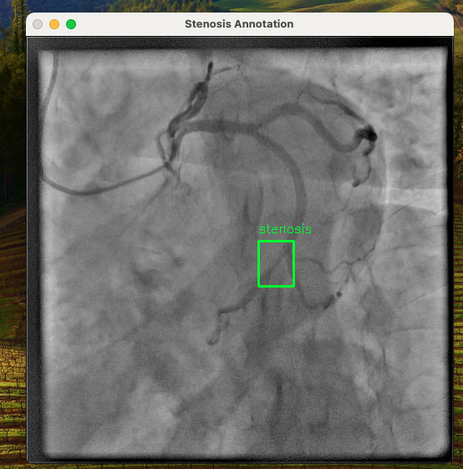
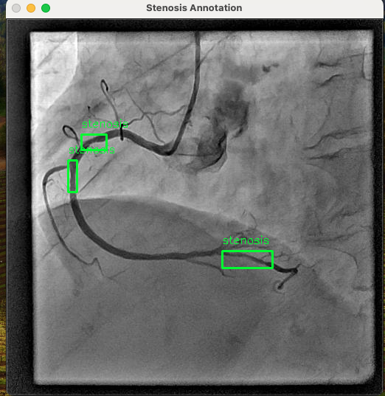
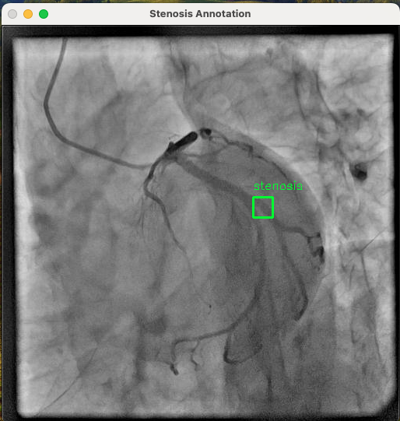
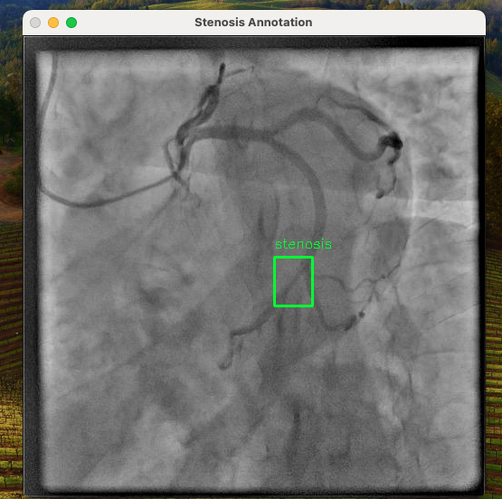
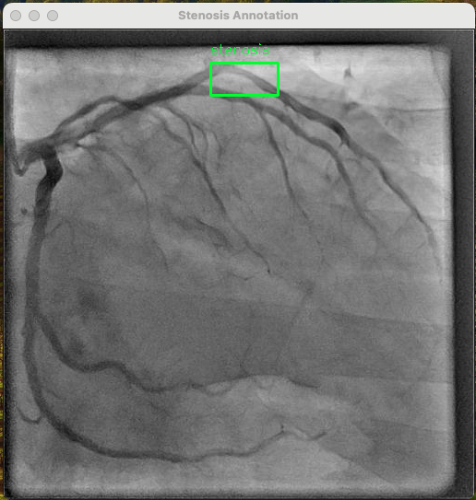
Session 0
COCO visualization

Slide 22
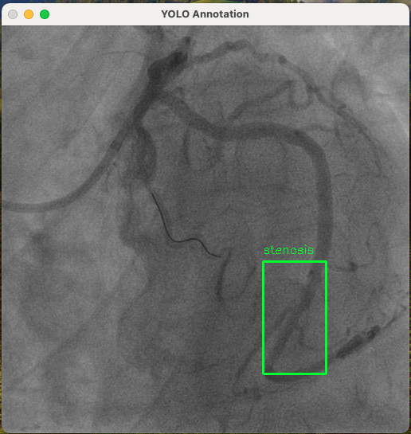
YOLO visualization
Session 0
Subset: 200 train images, 50 val images, 10 epochs
mAP50 of 0.044, mAP50-95 of 0.0129
Training completed 10 epochs, with losses (box, classification, distribution focal loss) decreasing, indicating the model learned something.
Processed 25 batches per epoch (200 images / batch size 8 ≈ 25), taking ~22 seconds per epoch on CPU (Apple M3 Pro).

Slide 23
Session 0
Evaluated on 50 validation images with 103 stenosis annotations.
Precision (P): 0.00581 (low, meaning many false positives).
Recall (R): 0.845 (high, meaning most stenosis regions were detected).mAP50: 0.044 (mean Average Precision at IoU=0.5, low due to small dataset).
mAP50-95: 0.0129 (average mAP across IoU thresholds, very low).

Slide 24
Session 0
For speed/accuracy optimization I need gpu!
Speed: 0.3ms preprocess, 92.0ms inference, 0.0ms loss, 2.1ms postprocess per image
Results saved to /Users/ibrayea/Desktop/arcade_yolo/stenosis_subset
Training complete
Task complete

Slide 25
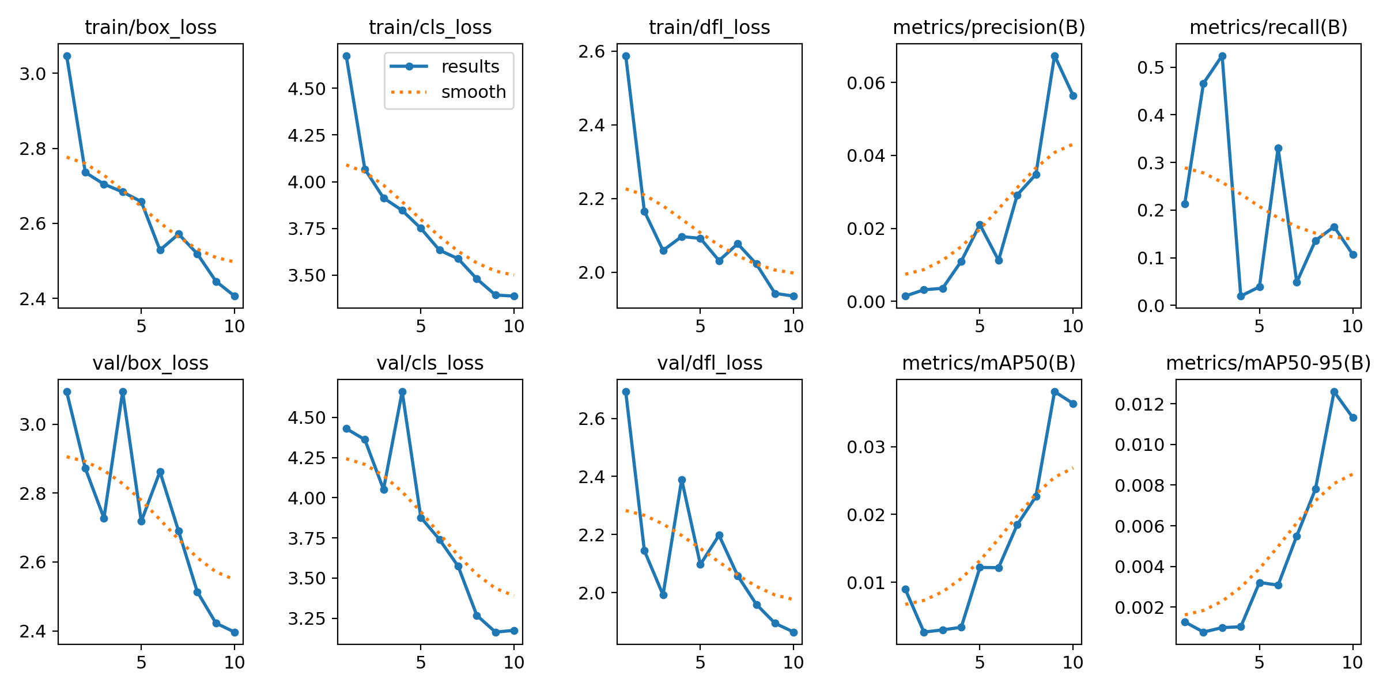
Session 0

Slide 26
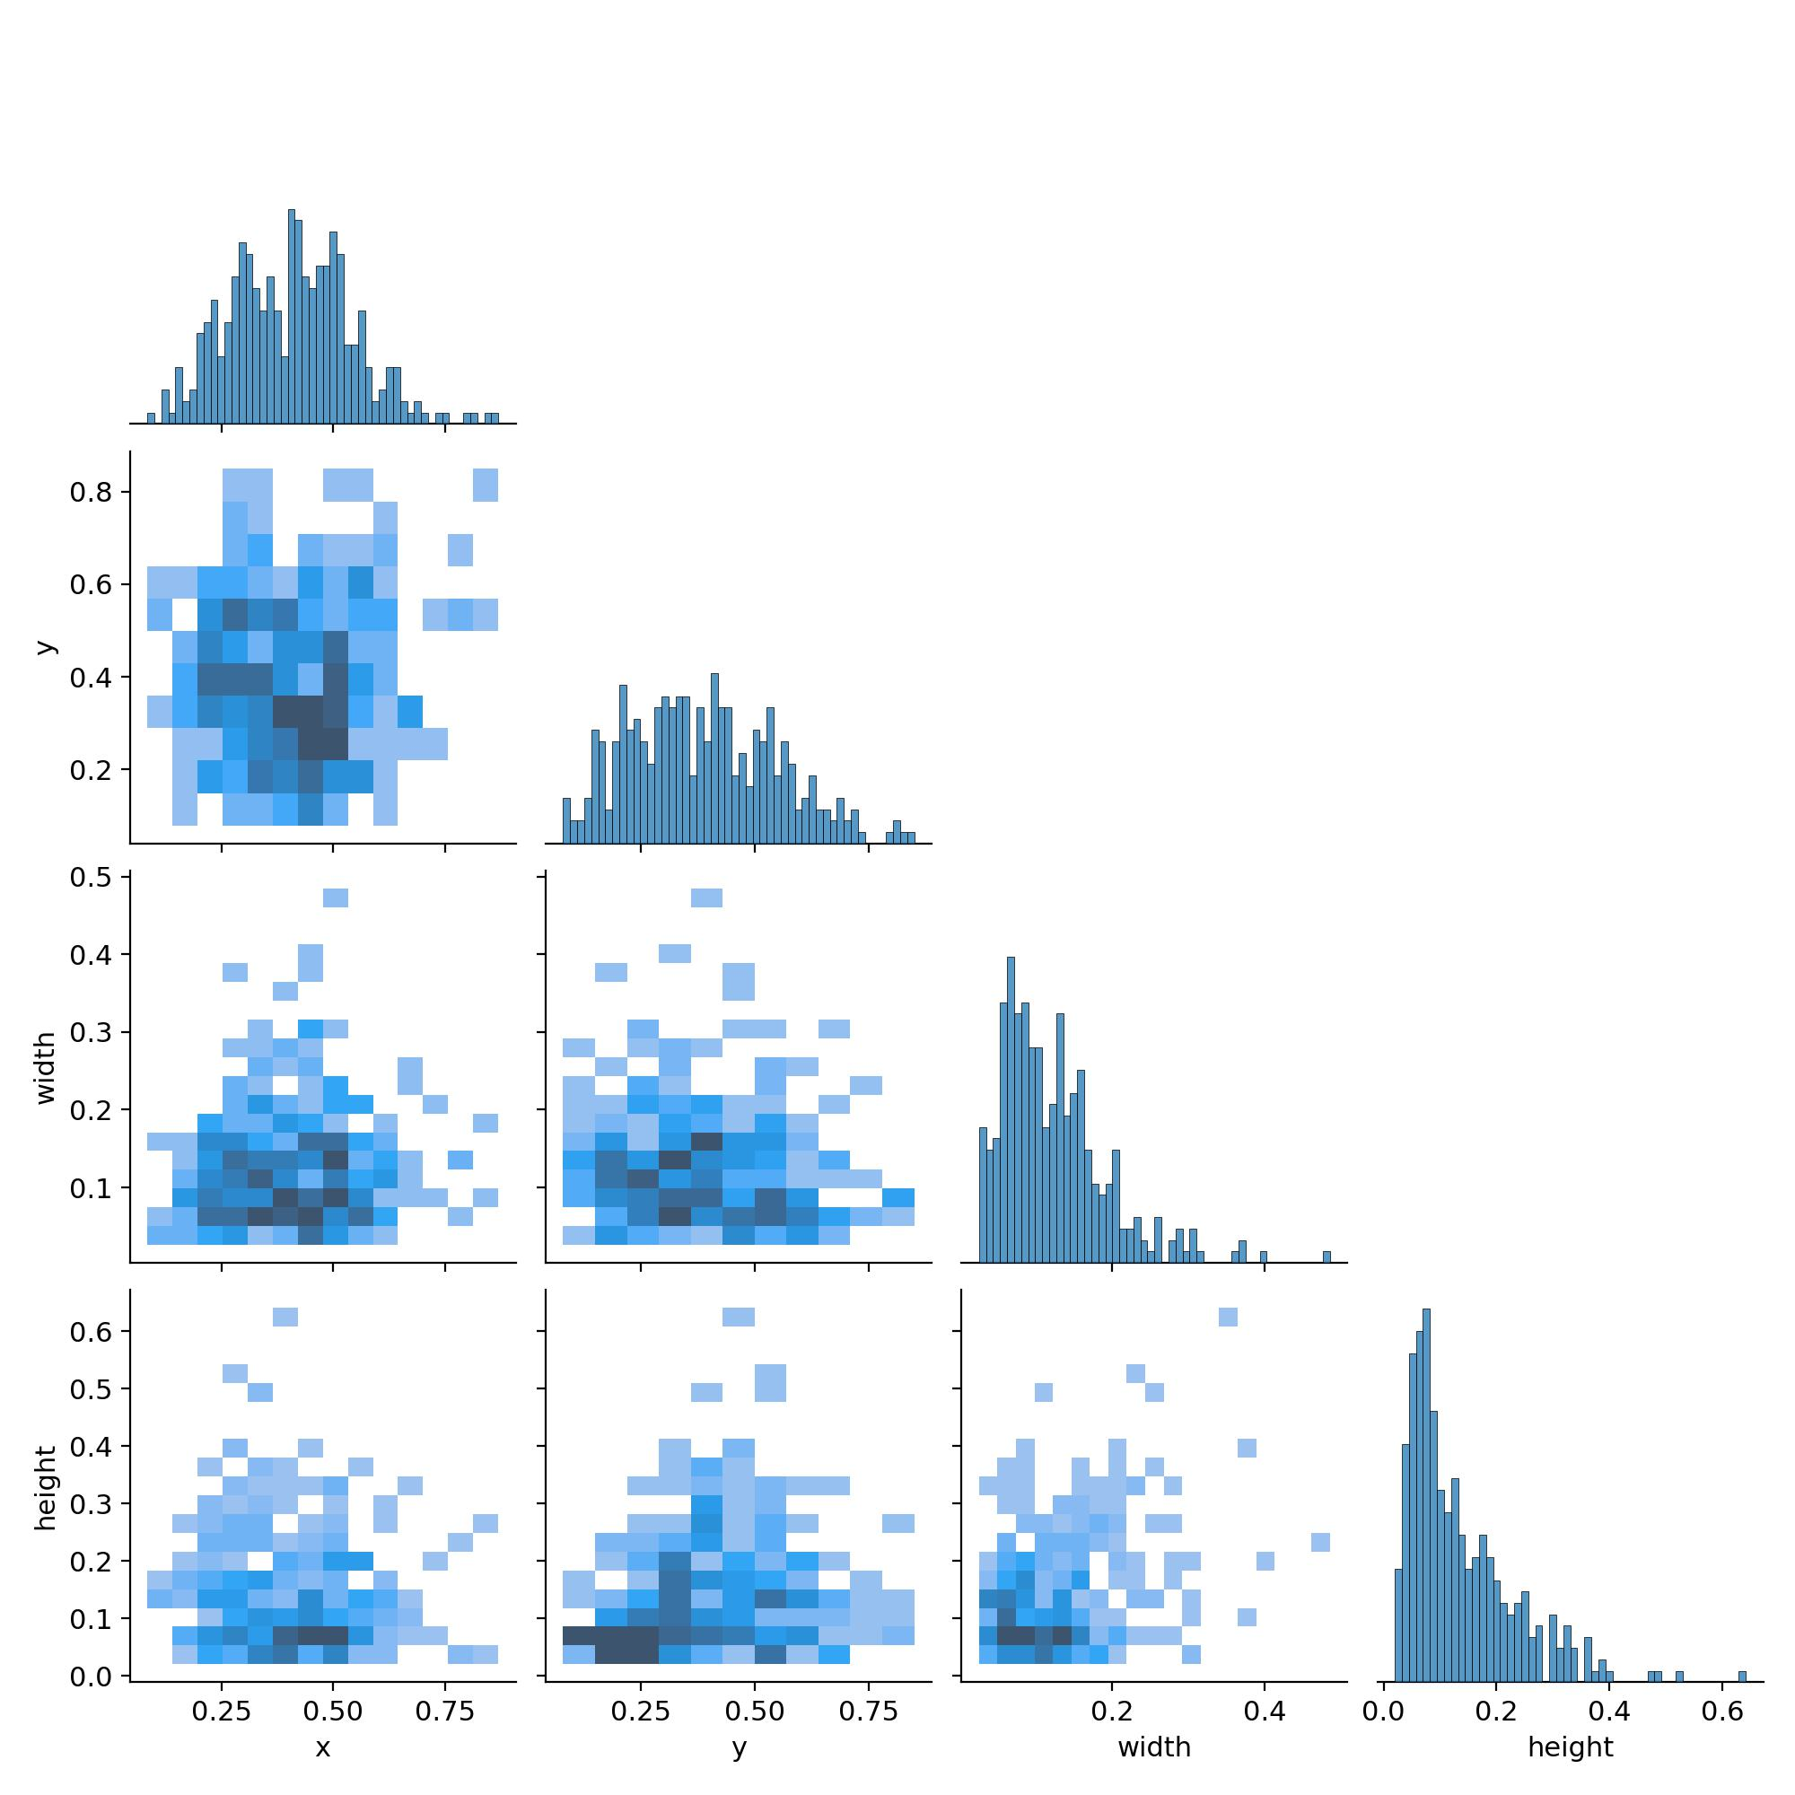
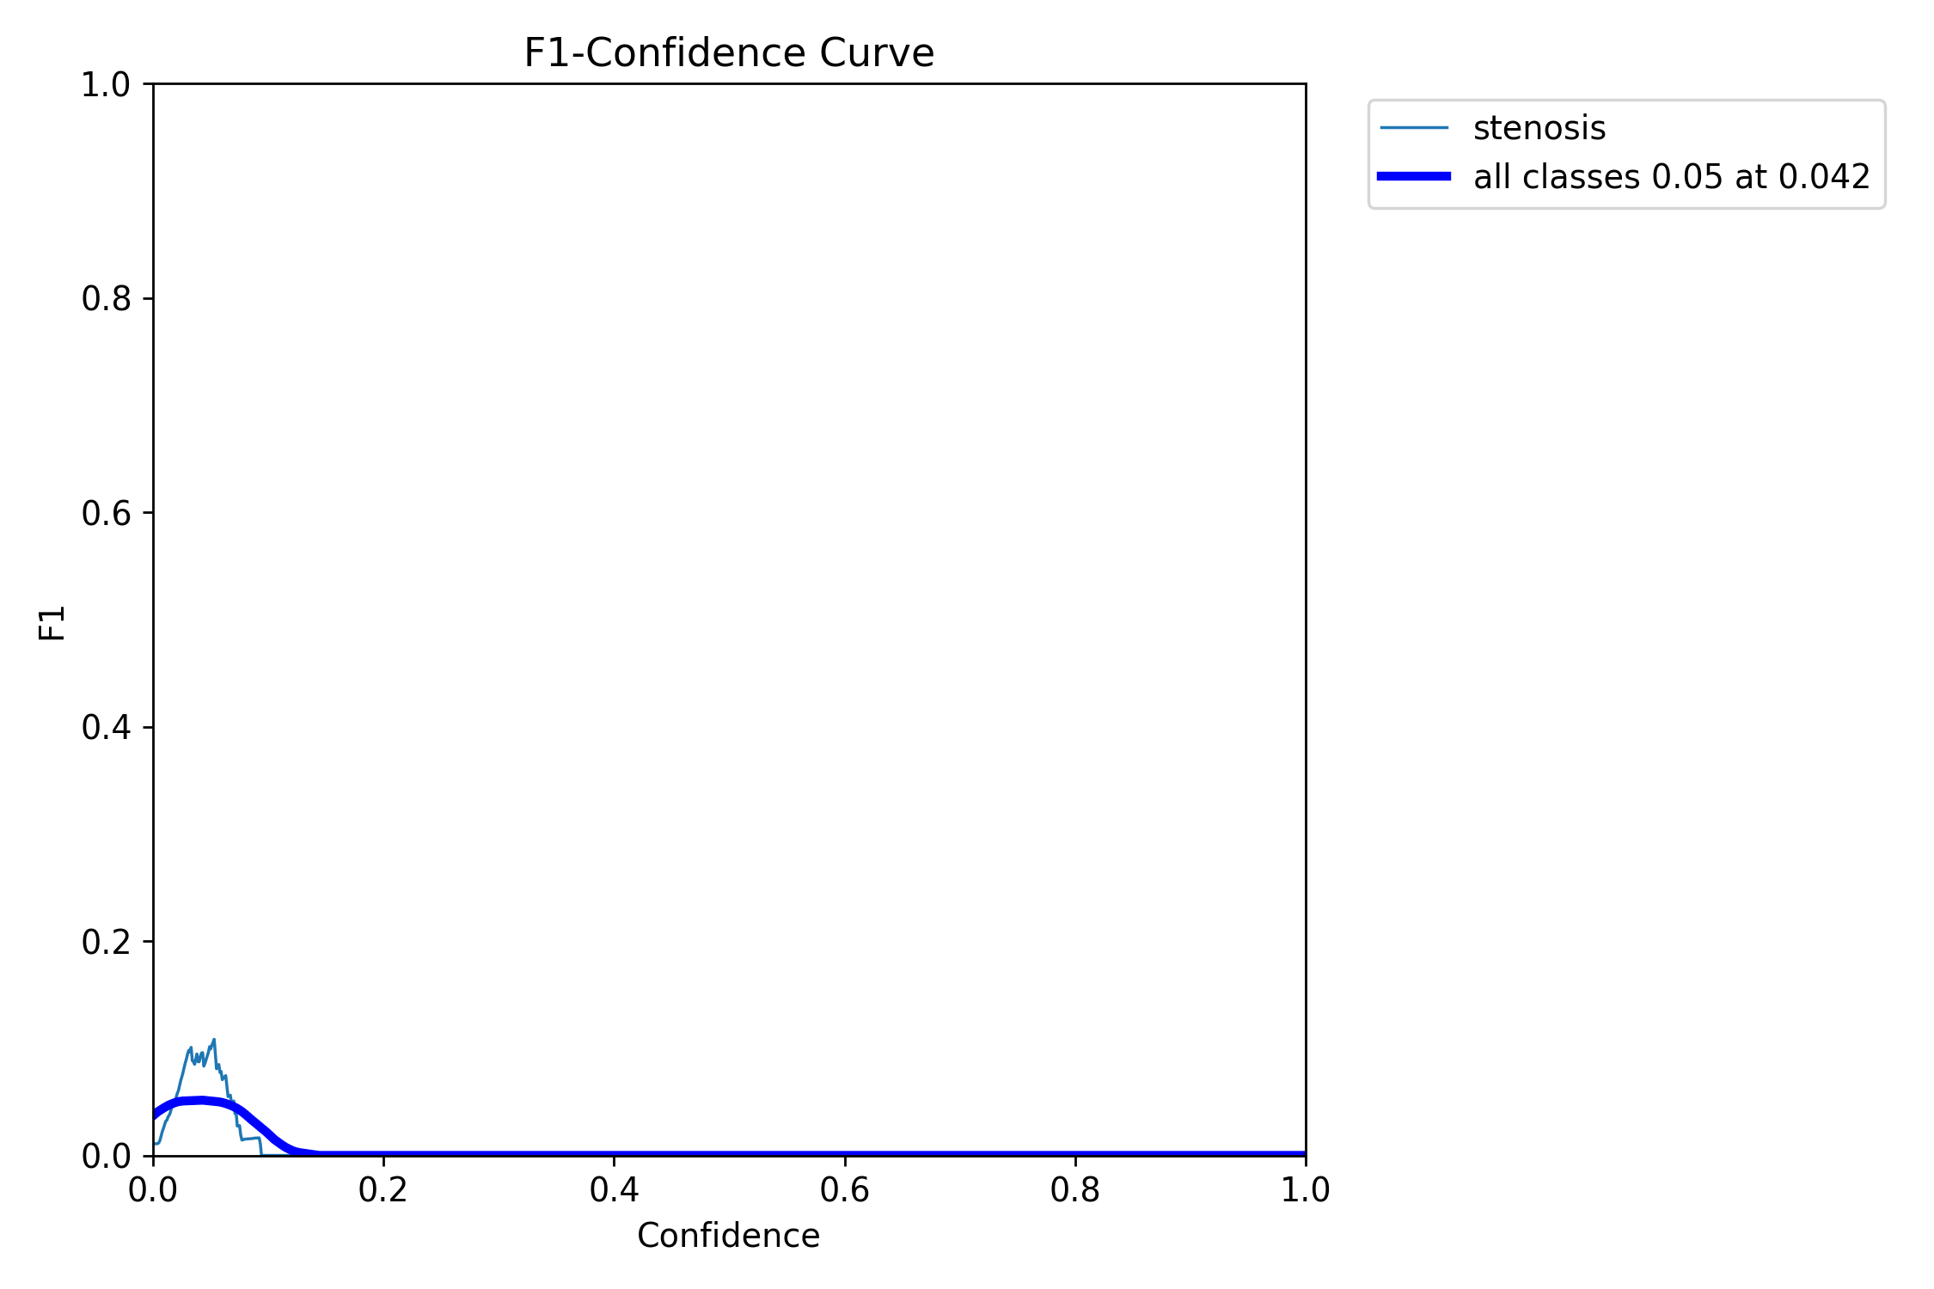
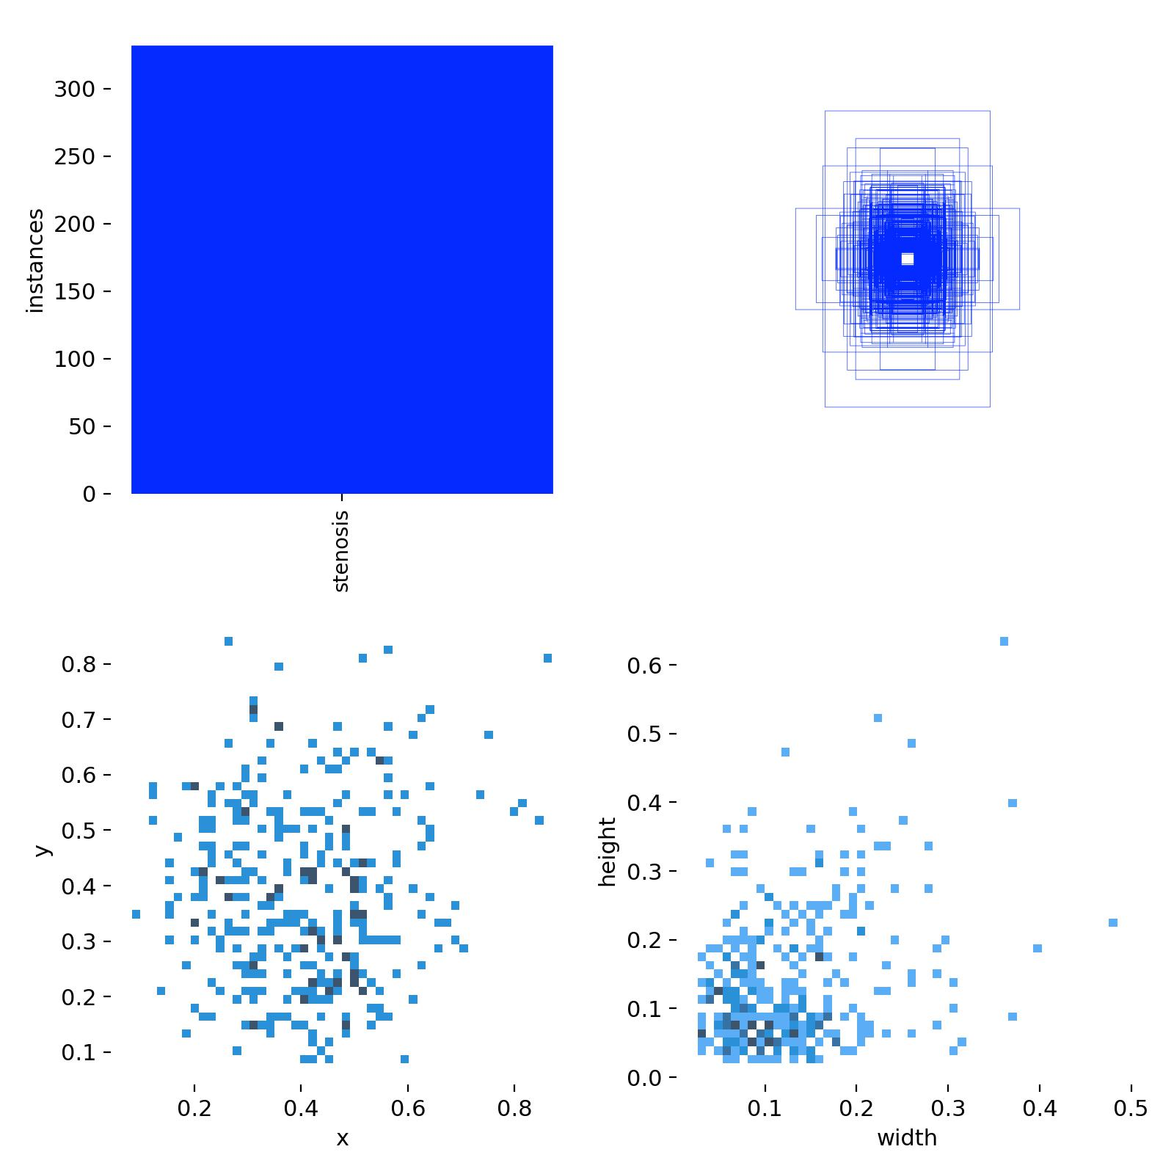
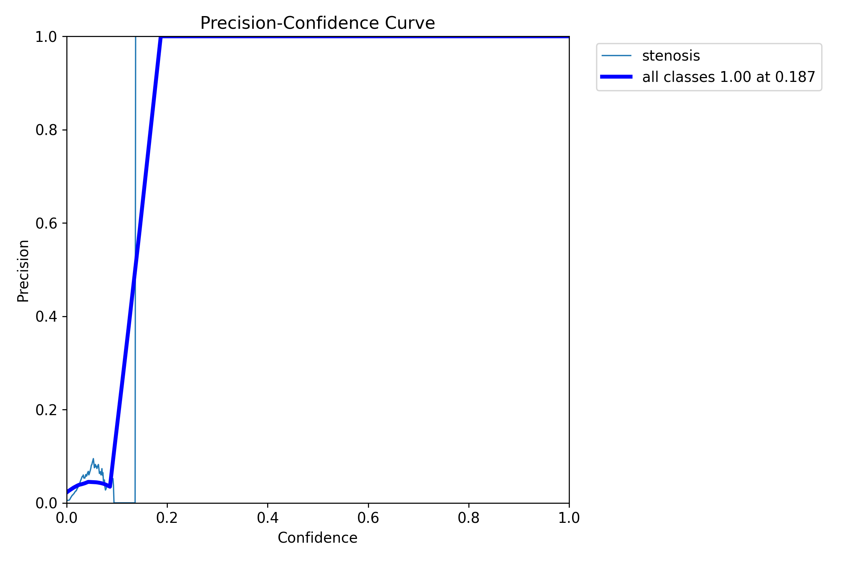
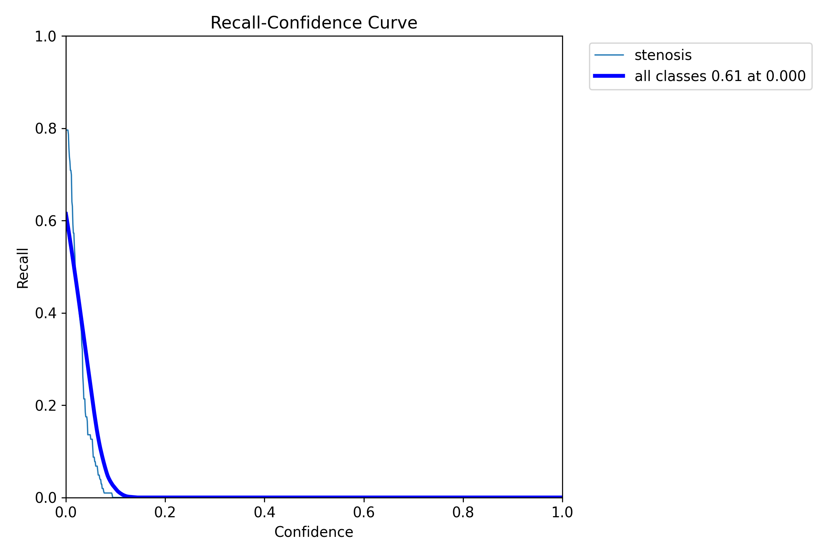
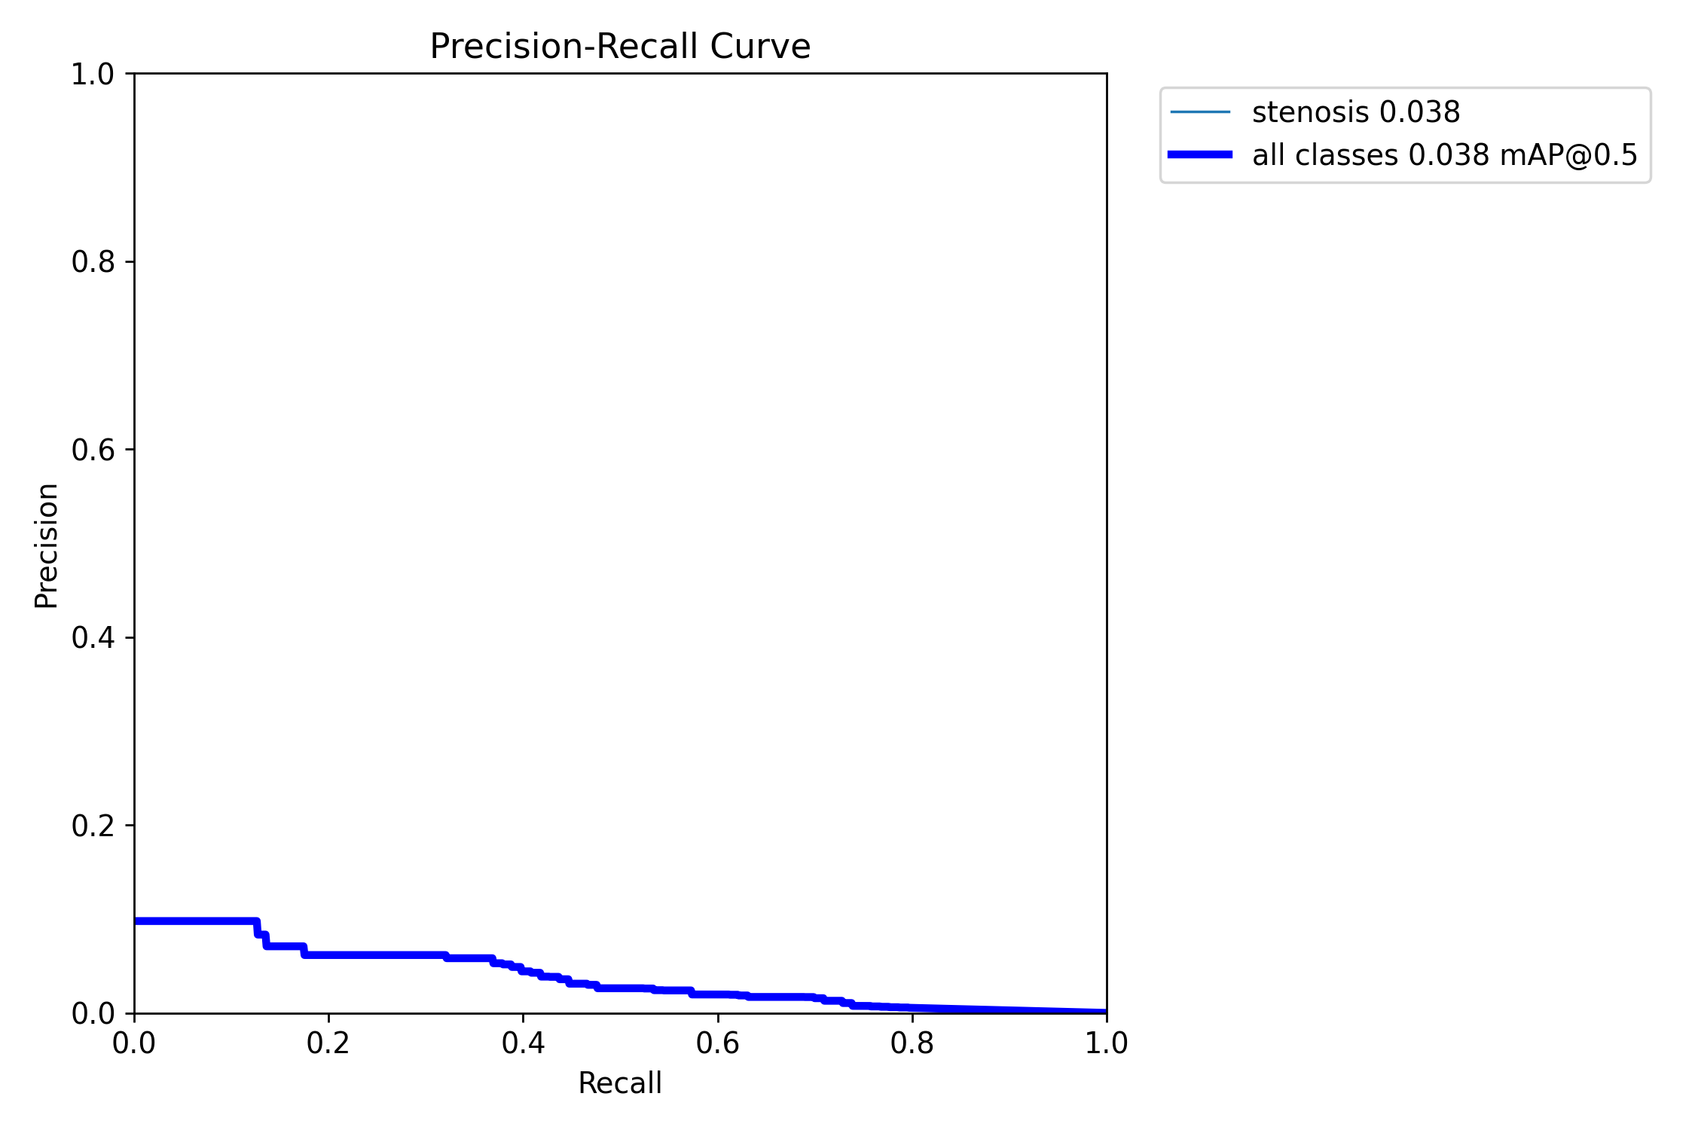
Session 0
labels
labels

Slide 27
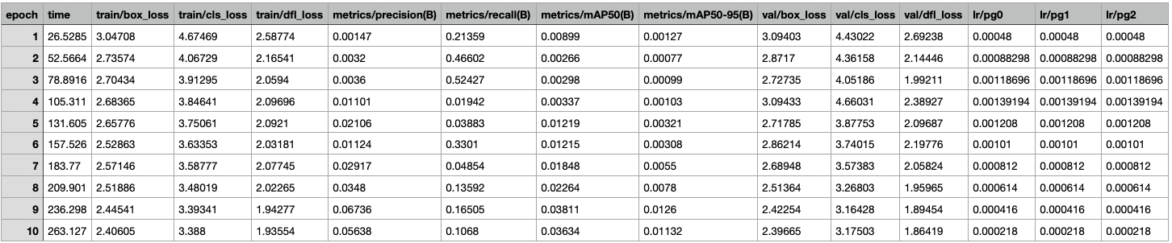
Session 0

Slide 28

Session 1

Slide 29
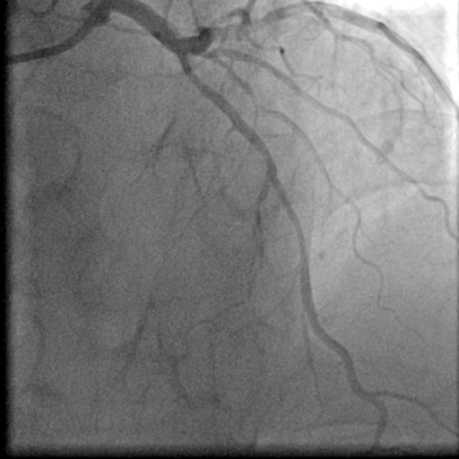
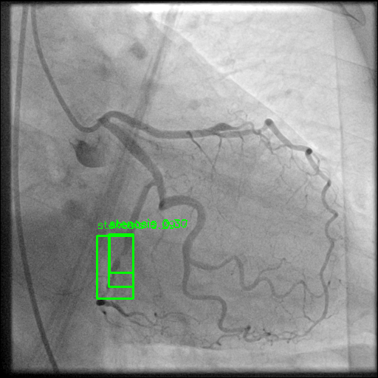
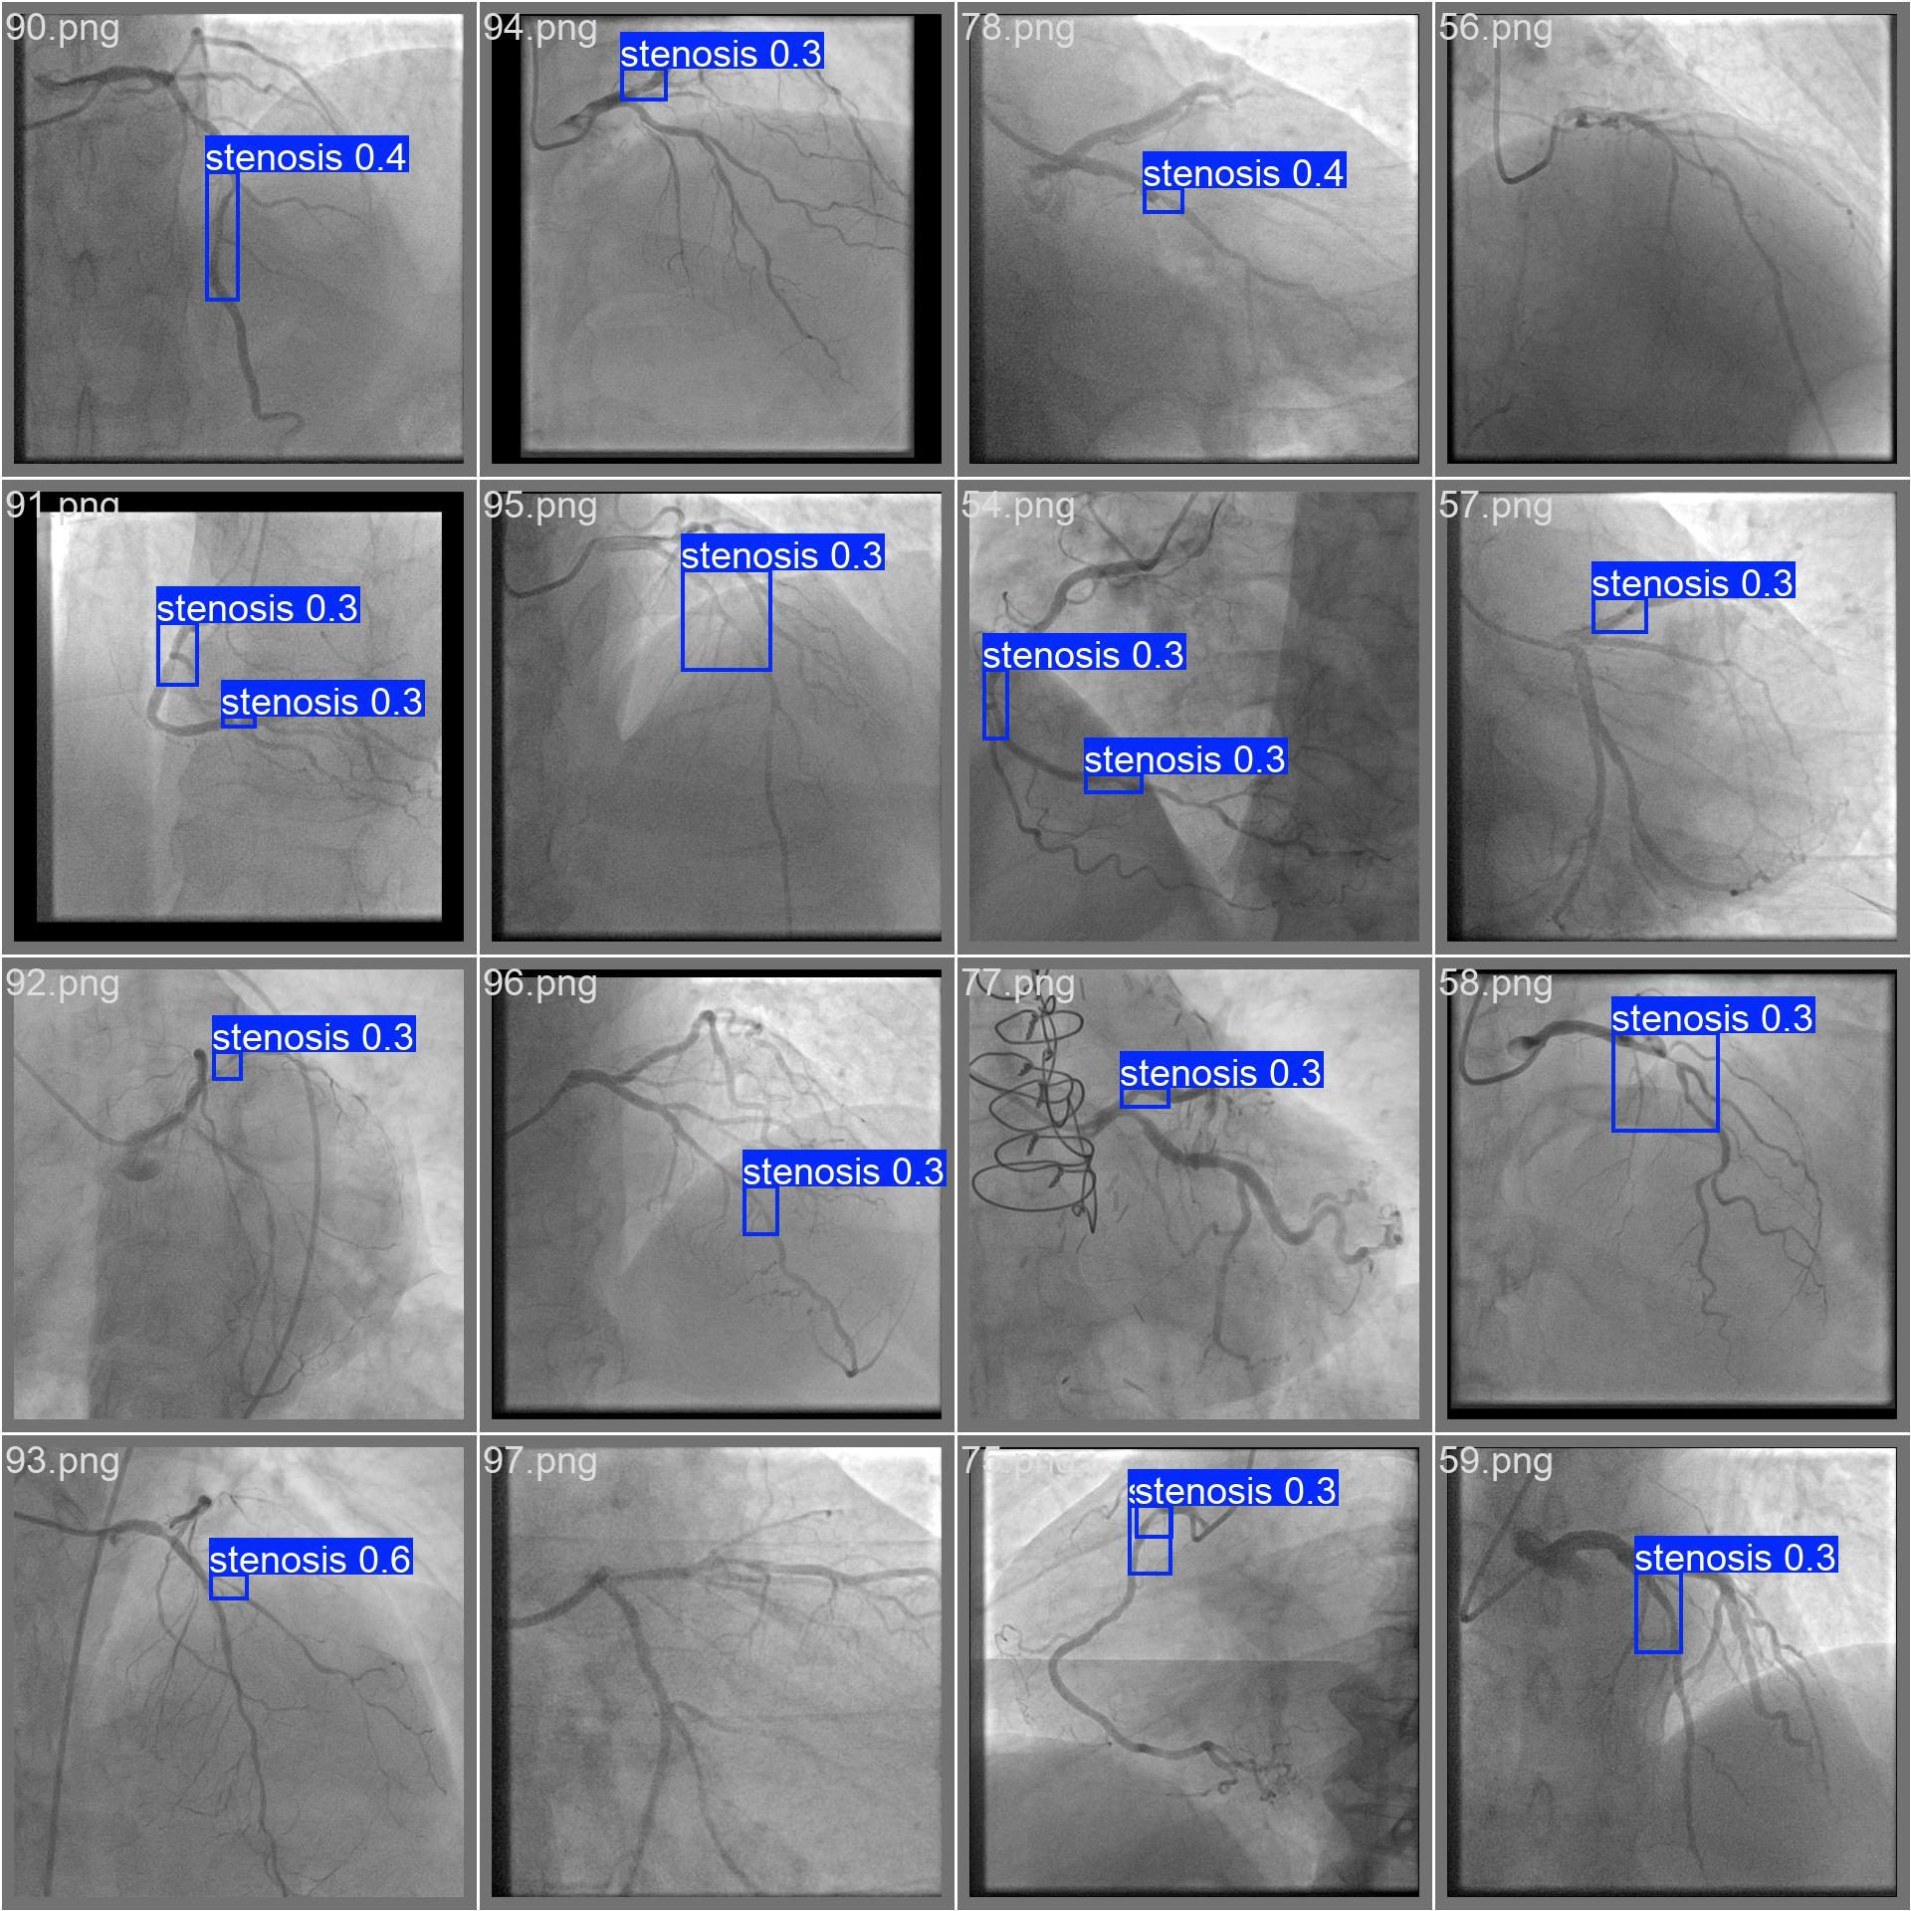
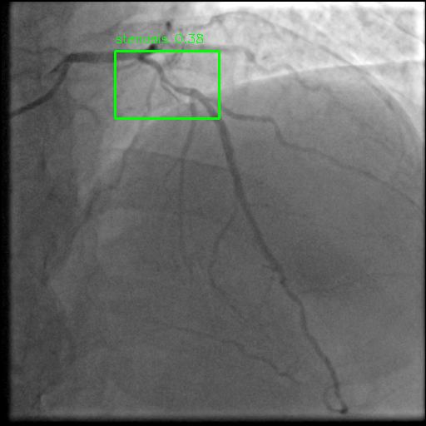
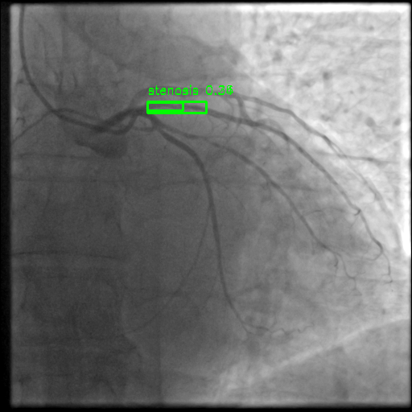
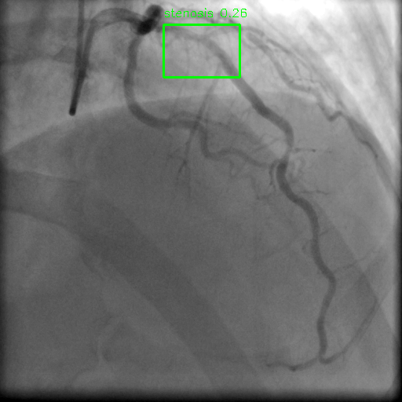
validation batch 2 – prediction
Test visualization

Slide 30
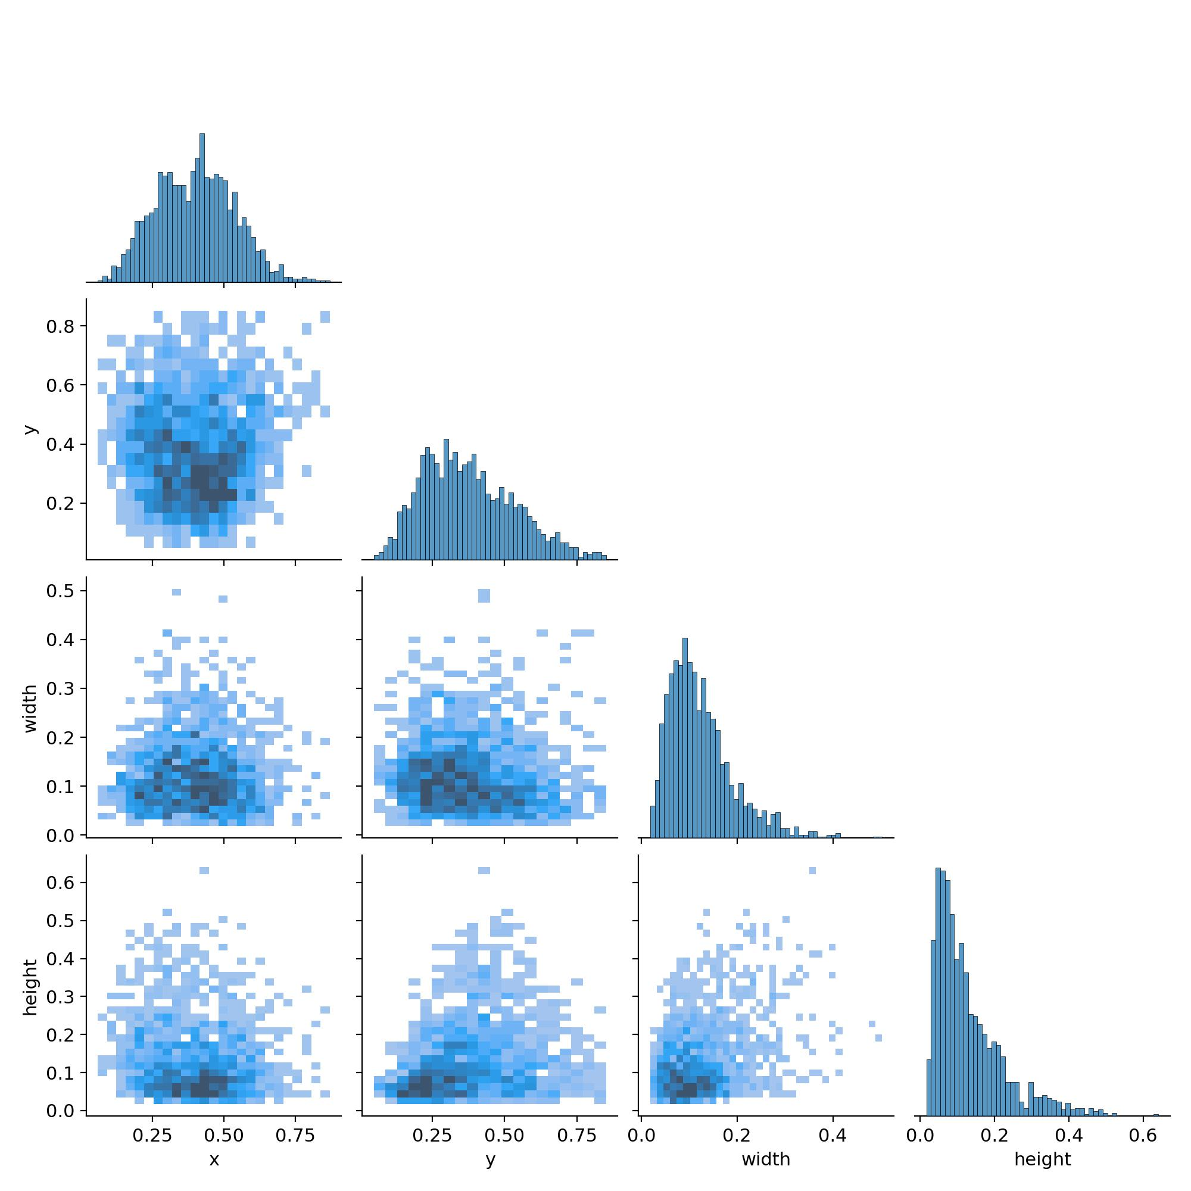
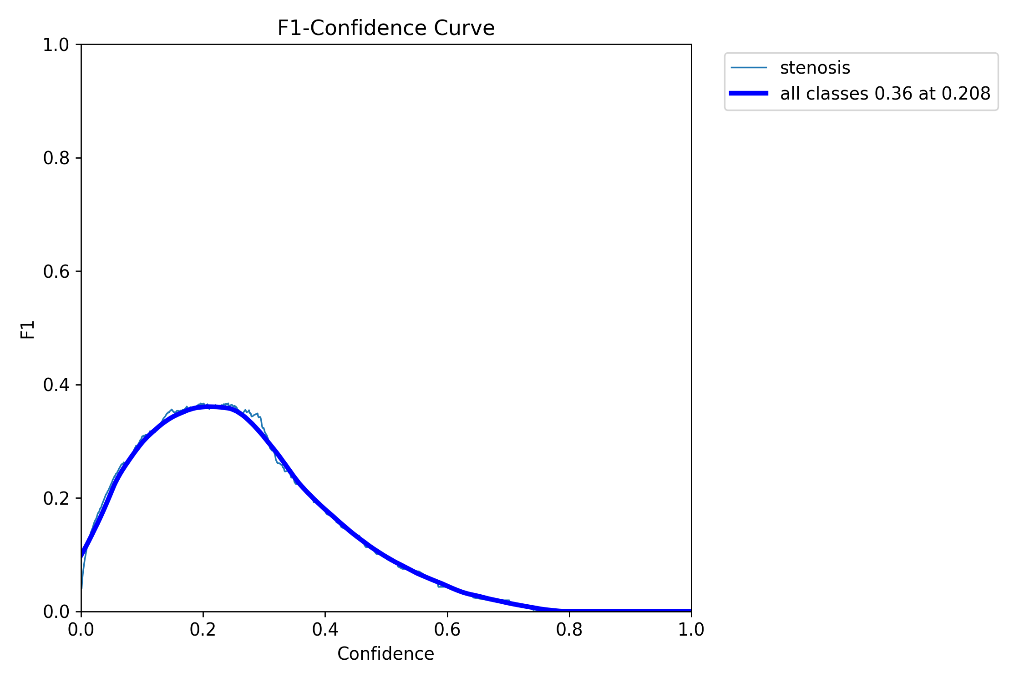
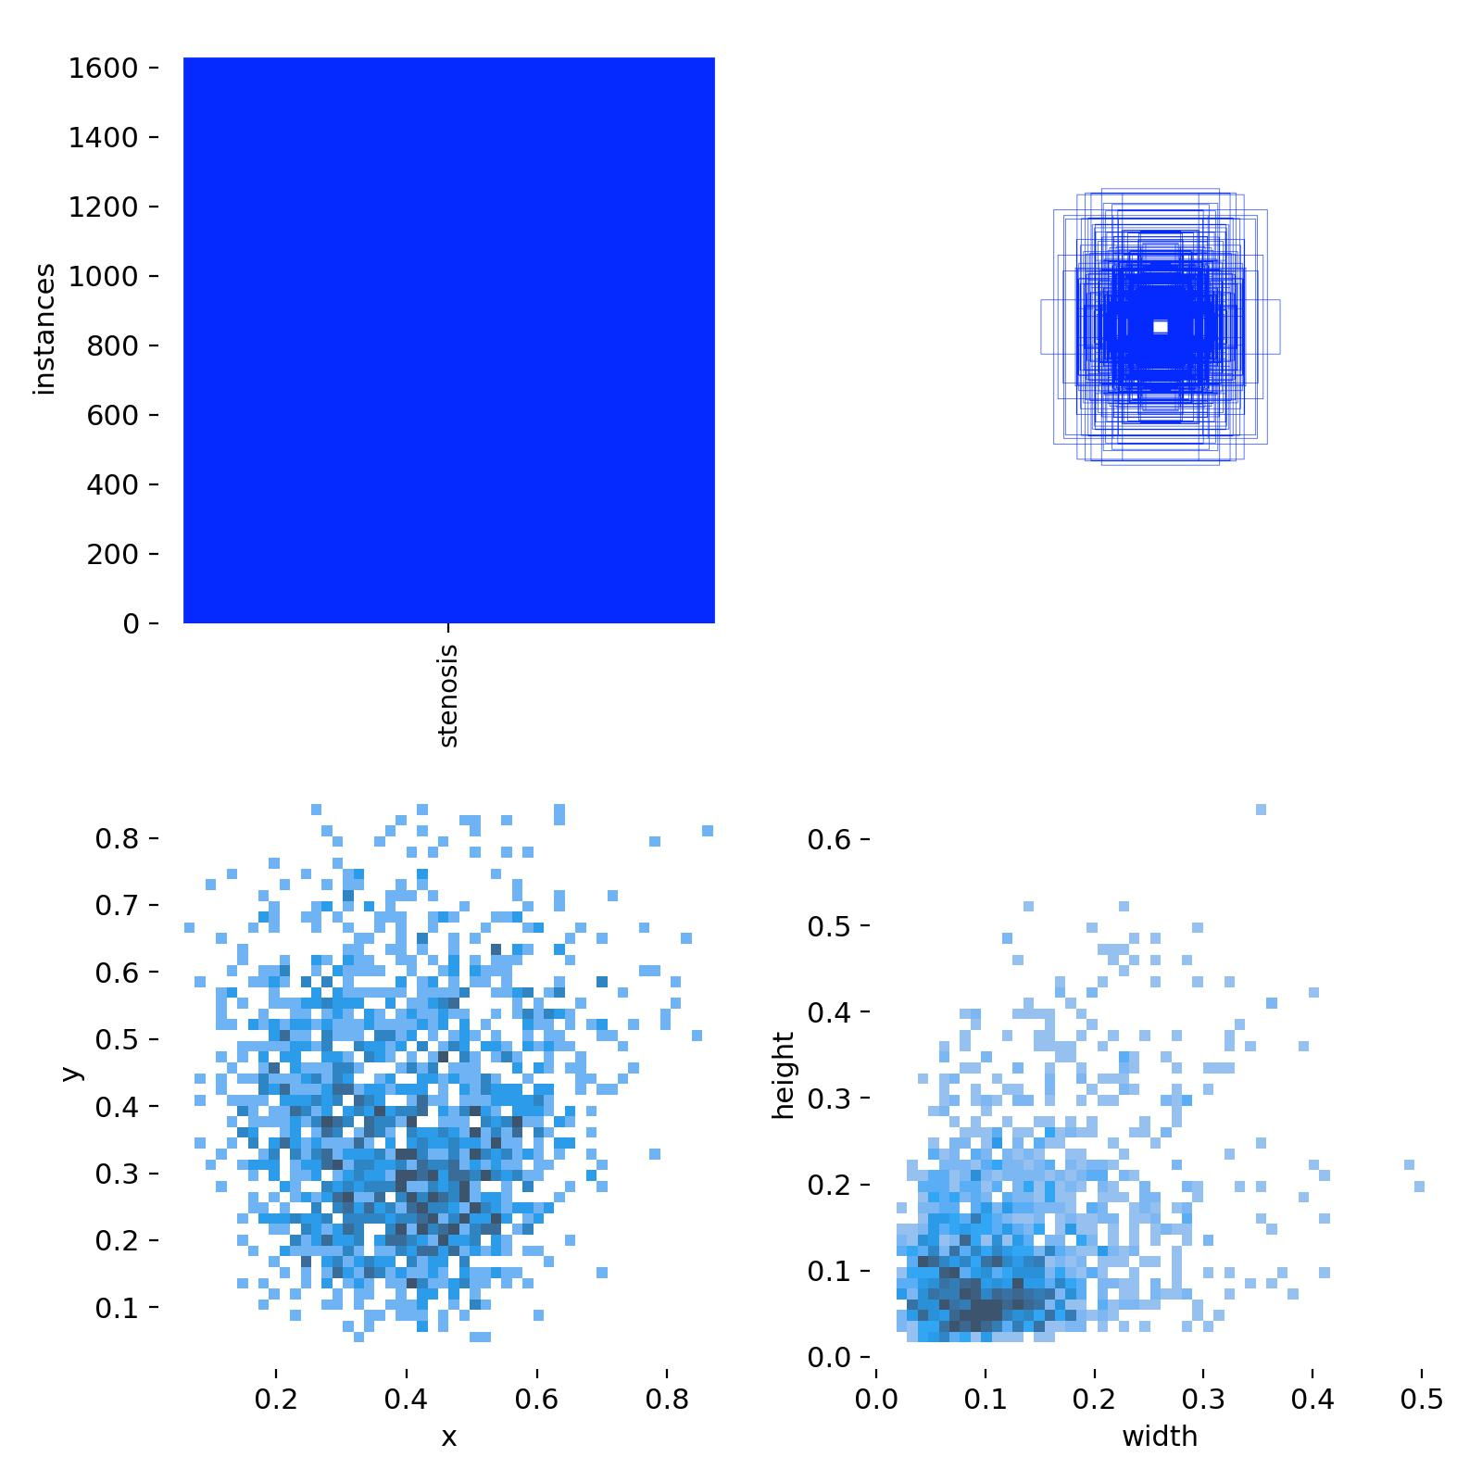
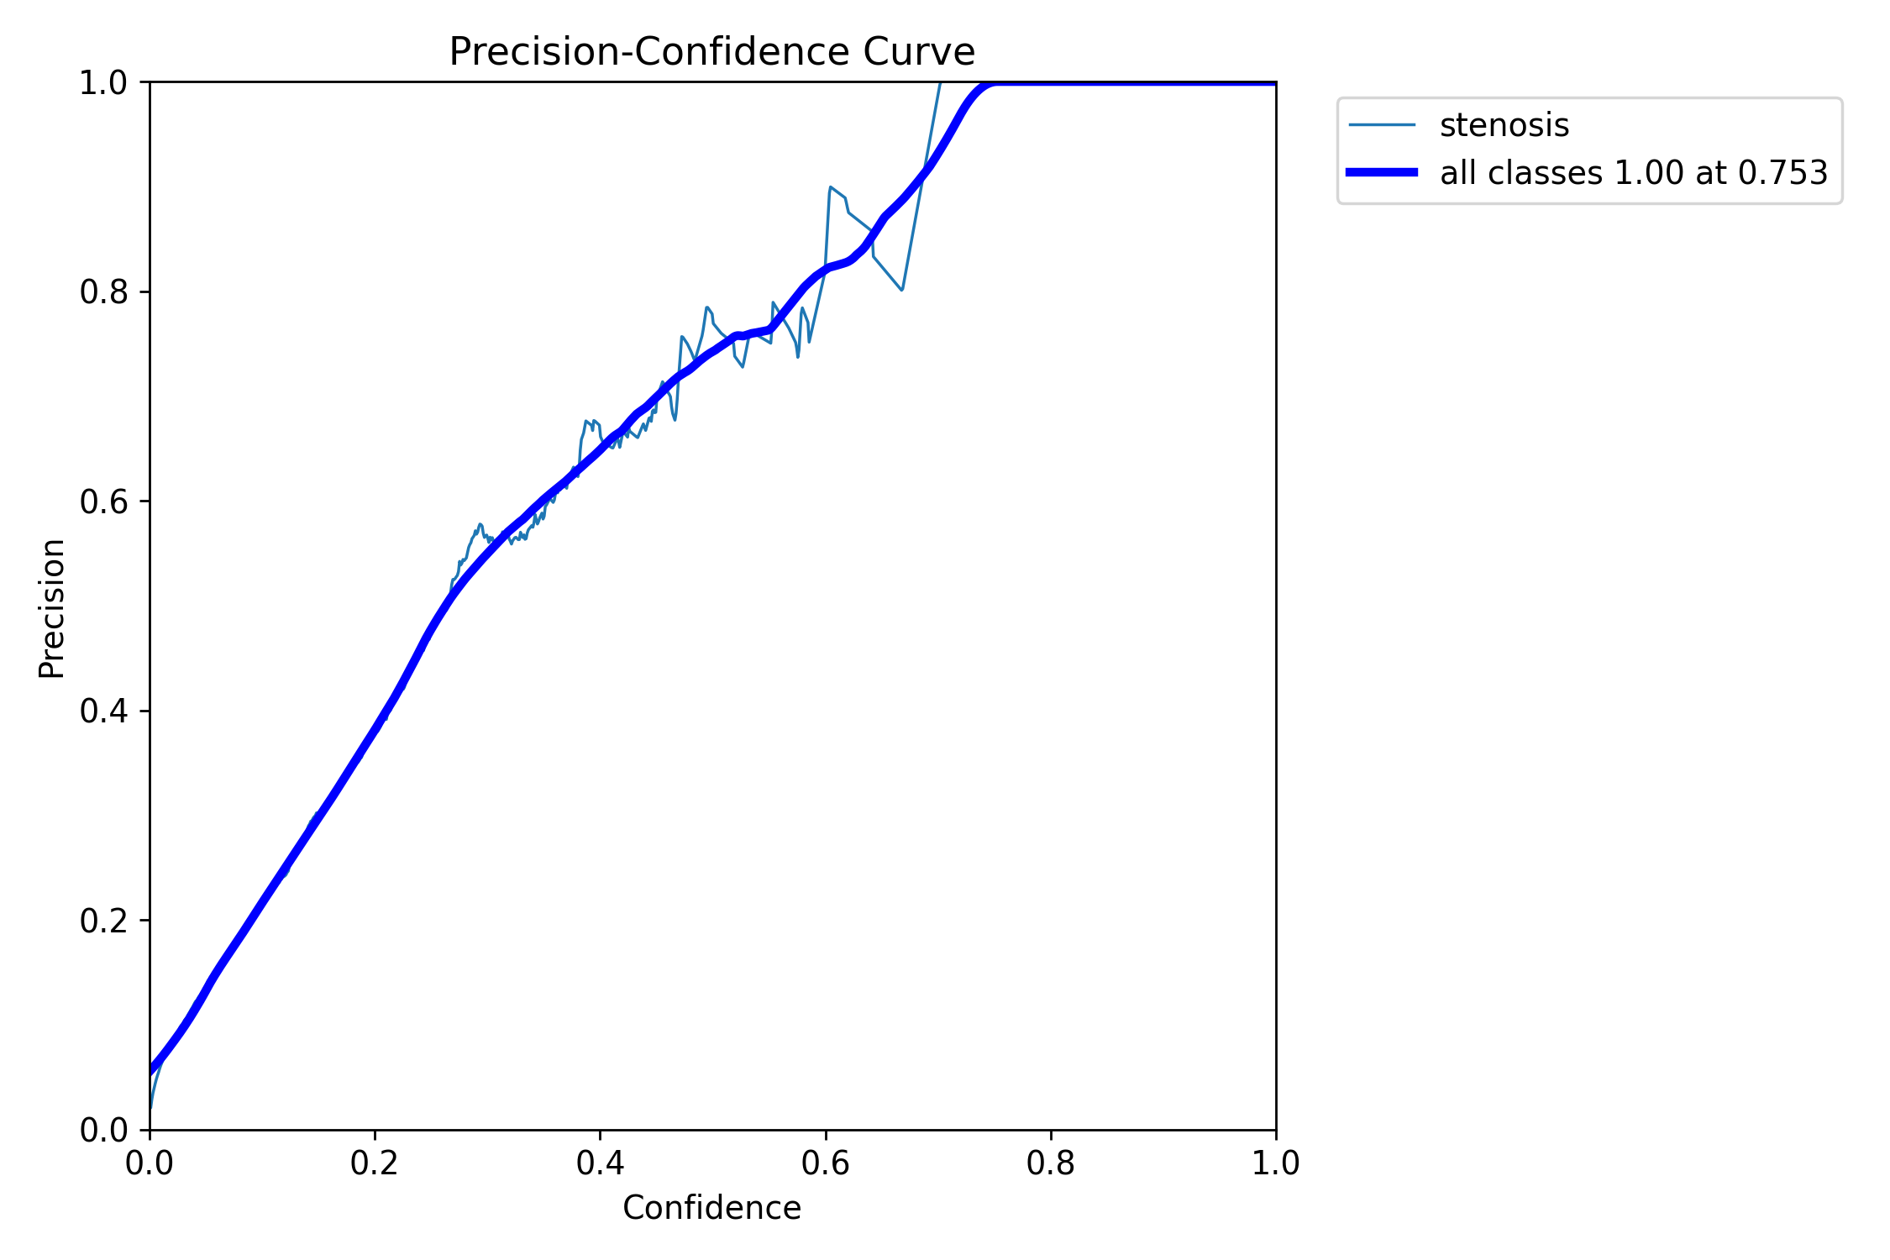
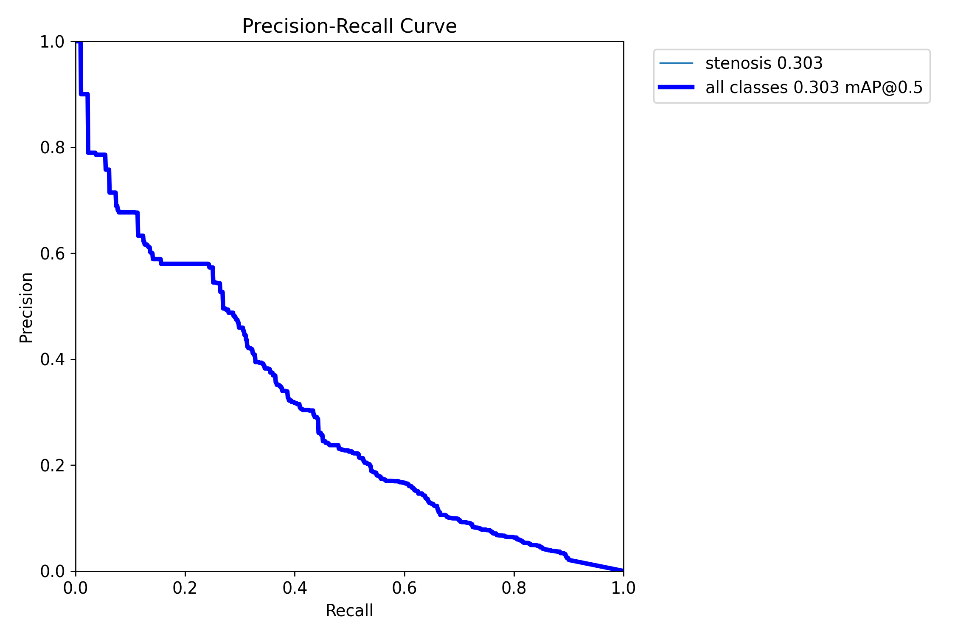
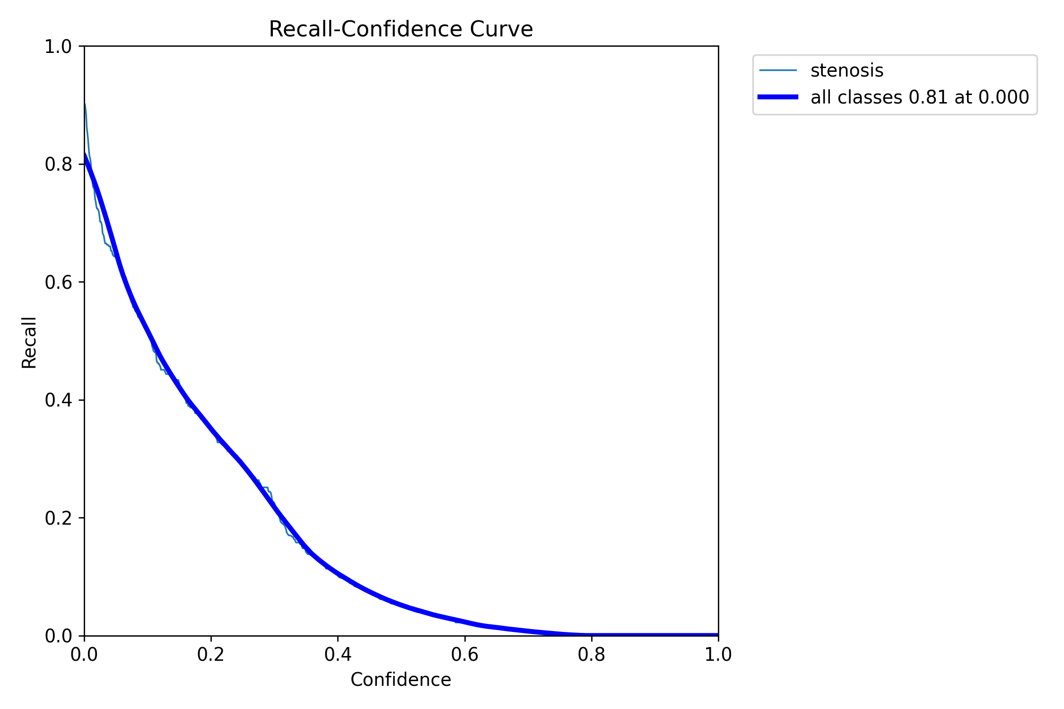
Session 1

Slide 31
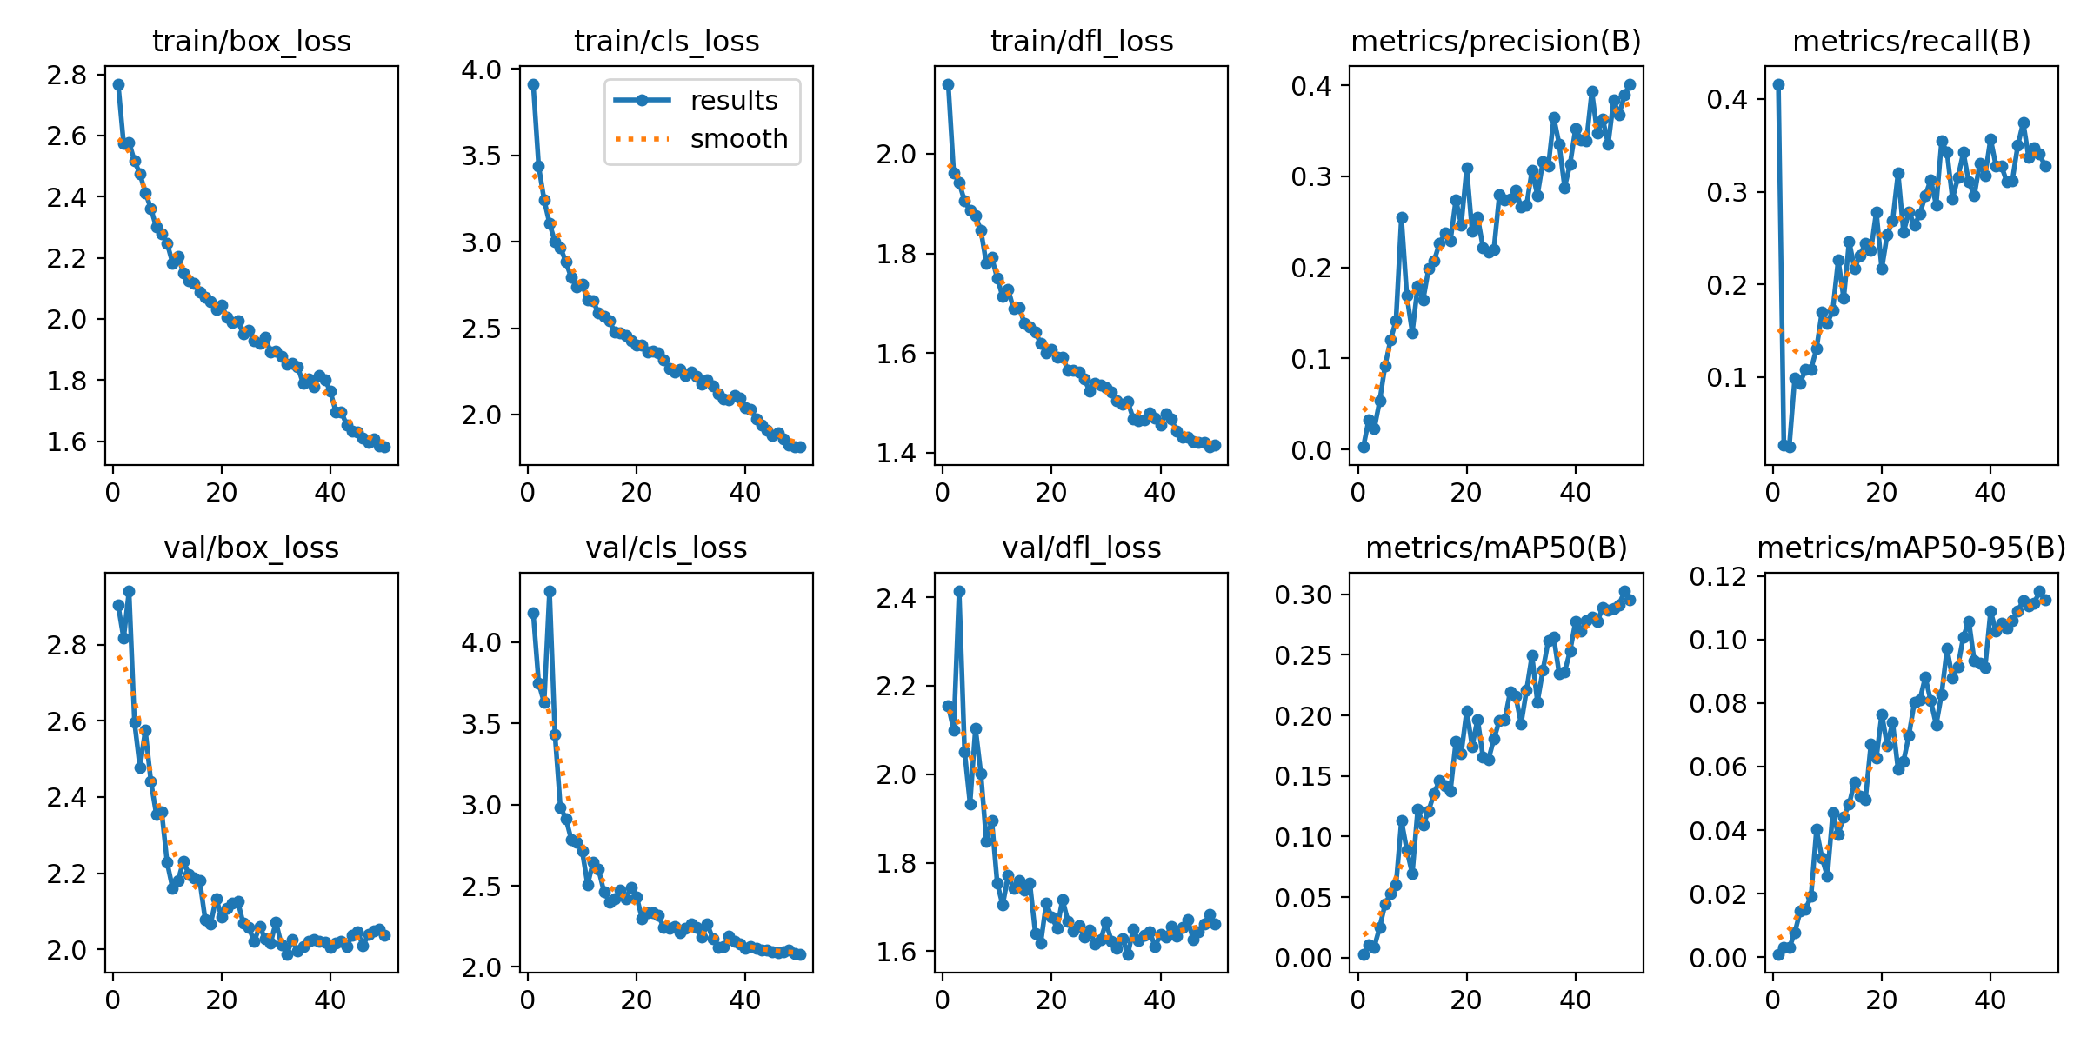
Session 1

Slide 32
epoch | time | train/box_loss | train/cls_loss | train/dfl_loss | metrics/precision(B) | metrics/recall(B) | metrics/mAP50(B) | metrics/mAP50-95(B) | val/box_loss | val/cls_loss | val/dfl_loss | lr/pg0 | lr/pg1 | lr/pg2
1 | 191.098 | 2.76885 | 3.91342 | 2.1404 | 0.00282 | 0.41626 | 0.00302 | 0.00097 | 2.90358 | 4.18044 | 2.15544 | 0.000656085 | 0.000656085 | 0.000656085
2 | 379.218 | 2.5733 | 3.43885 | 1.96224 | 0.03305 | 0.02709 | 0.0107 | 0.00307 | 2.81649 | 3.7499 | 2.09924 | 0.00129656 | 0.00129656 | 0.00129656
3 | 565.854 | 2.57771 | 3.24353 | 1.94198 | 0.02271 | 0.02463 | 0.00883 | 0.00297 | 2.94065 | 3.62802 | 2.41394 | 0.00191064 | 0.00191064 | 0.00191064
4 | 752.71 | 2.51648 | 3.10614 | 1.90537 | 0.05321 | 0.09852 | 0.02493 | 0.00762 | 2.59705 | 4.31451 | 2.05124 | 0.0018812 | 0.0018812 | 0.0018812
5 | 939.946 | 2.47439 | 2.9983 | 1.88579 | 0.09213 | 0.0936 | 0.04432 | 0.01444 | 2.47775 | 3.43312 | 1.93383 | 0.0018416 | 0.0018416 | 0.0018416
6 | 1127.28 | 2.41357 | 2.96774 | 1.87615 | 0.12016 | 0.10837 | 0.05269 | 0.01509 | 2.57588 | 2.9807 | 2.10408 | 0.001802 | 0.001802 | 0.001802
7 | 1311 | 2.36237 | 2.88247 | 1.84606 | 0.14157 | 0.10837 | 0.05983 | 0.01918 | 2.44197 | 2.91374 | 2.00163 | 0.0017624 | 0.0017624 | 0.0017624
8 | 1484.48 | 2.3007 | 2.7922 | 1.7793 | 0.25501 | 0.13054 | 0.11313 | 0.04016 | 2.35545 | 2.78466 | 1.84832 | 0.0017228 | 0.0017228 | 0.0017228
9 | 1658.82 | 2.2781 | 2.73819 | 1.79212 | 0.16869 | 0.16994 | 0.08883 | 0.03129 | 2.36111 | 2.76752 | 1.8959 | 0.0016832 | 0.0016832 | 0.0016832
10 | 1833.09 | 2.24801 | 2.75177 | 1.75051 | 0.12823 | 0.15764 | 0.0692 | 0.02545 | 2.22825 | 2.71415 | 1.75376 | 0.0016436 | 0.0016436 | 0.0016436
11 | 2007.56 | 2.18244 | 2.66553 | 1.71319 | 0.17965 | 0.17241 | 0.12269 | 0.04558 | 2.16054 | 2.50655 | 1.70476 | 0.001604 | 0.001604 | 0.001604
12 | 2182.24 | 2.20437 | 2.65748 | 1.72804 | 0.1647 | 0.2266 | 0.10965 | 0.03864 | 2.18048 | 2.64489 | 1.7711 | 0.0015644 | 0.0015644 | 0.0015644
13 | 2356.94 | 2.15152 | 2.58565 | 1.6884 | 0.19887 | 0.18473 | 0.12131 | 0.04415 | 2.2315 | 2.60285 | 1.74172 | 0.0015248 | 0.0015248 | 0.0015248
14 | 2531.5 | 2.12636 | 2.56641 | 1.69152 | 0.20706 | 0.24631 | 0.13564 | 0.04814 | 2.19645 | 2.4644 | 1.75995 | 0.0014852 | 0.0014852 | 0.0014852
15 | 2705.99 | 2.11513 | 2.54078 | 1.66021 | 0.22653 | 0.21675 | 0.14617 | 0.05515 | 2.18823 | 2.39847 | 1.73773 | 0.0014456 | 0.0014456 | 0.0014456
16 | 2880.49 | 2.08733 | 2.47751 | 1.65219 | 0.23745 | 0.23153 | 0.14192 | 0.05055 | 2.18029 | 2.41782 | 1.75382 | 0.001406 | 0.001406 | 0.001406
17 | 3055.28 | 2.0714 | 2.47037 | 1.6414 | 0.22889 | 0.24384 | 0.13734 | 0.04954 | 2.07785 | 2.47464 | 1.64038 | 0.0013664 | 0.0013664 | 0.0013664
18 | 3230.02 | 2.05702 | 2.45815 | 1.61912 | 0.27418 | 0.23645 | 0.17844 | 0.06699 | 2.06749 | 2.41956 | 1.6181 | 0.0013268 | 0.0013268 | 0.0013268
19 | 3404.66 | 2.03072 | 2.42483 | 1.60059 | 0.24683 | 0.27833 | 0.16877 | 0.06262 | 2.13405 | 2.48983 | 1.70899 | 0.0012872 | 0.0012872 | 0.0012872
20 | 3578.94 | 2.04497 | 2.40129 | 1.6066 | 0.30915 | 0.21675 | 0.20399 | 0.07652 | 2.08603 | 2.4326 | 1.67708 | 0.0012476 | 0.0012476 | 0.0012476
21 | 3753.47 | 2.0063 | 2.40149 | 1.59223 | 0.23935 | 0.25369 | 0.17456 | 0.06663 | 2.10826 | 2.29903 | 1.65268 | 0.001208 | 0.001208 | 0.001208
22 | 3927.87 | 1.98883 | 2.36152 | 1.59178 | 0.25549 | 0.26847 | 0.19668 | 0.07396 | 2.12118 | 2.33435 | 1.71645 | 0.0011684 | 0.0011684 | 0.0011684
23 | 4102.53 | 1.99302 | 2.36469 | 1.56457 | 0.22183 | 0.3202 | 0.16553 | 0.05906 | 2.12558 | 2.3323 | 1.66791 | 0.0011288 | 0.0011288 | 0.0011288
24 | 4277.27 | 1.95066 | 2.35589 | 1.5653 | 0.21674 | 0.25616 | 0.16368 | 0.06166 | 2.06804 | 2.3183 | 1.64611 | 0.0010892 | 0.0010892 | 0.0010892
25 | 4452.19 | 1.96382 | 2.31775 | 1.56159 | 0.21995 | 0.27833 | 0.18063 | 0.06991 | 2.05825 | 2.2419 | 1.65839 | 0.0010496 | 0.0010496 | 0.0010496
26 | 4626.7 | 1.9299 | 2.26775 | 1.54804 | 0.27945 | 0.26355 | 0.19562 | 0.0803 | 2.02025 | 2.23613 | 1.63256 | 0.00101 | 0.00101 | 0.00101
27 | 4801.28 | 1.91984 | 2.24474 | 1.5229 | 0.27401 | 0.27586 | 0.19682 | 0.08098 | 2.06108 | 2.24694 | 1.64729 | 0.0009704 | 0.0009704 | 0.0009704
28 | 4975.88 | 1.94109 | 2.26136 | 1.54001 | 0.27505 | 0.29557 | 0.2196 | 0.08816 | 2.02789 | 2.21021 | 1.61634 | 0.0009308 | 0.0009308 | 0.0009308
29 | 5150.47 | 1.89214 | 2.22792 | 1.53595 | 0.28506 | 0.31281 | 0.21586 | 0.08076 | 2.01618 | 2.23844 | 1.62605 | 0.0008912 | 0.0008912 | 0.0008912
30 | 5324.65 | 1.89443 | 2.24598 | 1.53027 | 0.26624 | 0.28571 | 0.19308 | 0.07314 | 2.07162 | 2.26528 | 1.66545 | 0.0008516 | 0.0008516 | 0.0008516
31 | 5499.09 | 1.87782 | 2.22273 | 1.52124 | 0.26854 | 0.35447 | 0.22096 | 0.08281 | 2.01258 | 2.24363 | 1.62248 | 0.000812 | 0.000812 | 0.000812
32 | 5673.46 | 1.85327 | 2.17566 | 1.50371 | 0.30639 | 0.34236 | 0.24952 | 0.09712 | 1.98773 | 2.18199 | 1.60613 | 0.0007724 | 0.0007724 | 0.0007724
33 | 5848.05 | 1.85384 | 2.19983 | 1.49735 | 0.27923 | 0.29199 | 0.21102 | 0.08782 | 2.02615 | 2.26353 | 1.62876 | 0.0007328 | 0.0007328 | 0.0007328
34 | 6022.11 | 1.8434 | 2.16731 | 1.50214 | 0.31607 | 0.31527 | 0.23732 | 0.09153 | 1.99564 | 2.17474 | 1.59372 | 0.0006932 | 0.0006932 | 0.0006932
35 | 6196.56 | 1.78915 | 2.12081 | 1.46782 | 0.31104 | 0.34236 | 0.26177 | 0.10087 | 2.00858 | 2.11874 | 1.6493 | 0.0006536 | 0.0006536 | 0.0006536
36 | 6371.21 | 1.80465 | 2.0895 | 1.46431 | 0.36452 | 0.31034 | 0.2644 | 0.10581 | 2.02208 | 2.1269 | 1.62426 | 0.000614 | 0.000614 | 0.000614
37 | 6544.5 | 1.77858 | 2.08638 | 1.46528 | 0.33514 | 0.29557 | 0.23424 | 0.09332 | 2.02555 | 2.1882 | 1.63543 | 0.0005744 | 0.0005744 | 0.0005744
38 | 6718.96 | 1.81402 | 2.10849 | 1.47902 | 0.28786 | 0.33005 | 0.23582 | 0.0926 | 2.02153 | 2.15845 | 1.64427 | 0.0005348 | 0.0005348 | 0.0005348
39 | 6893.76 | 1.80184 | 2.09558 | 1.46981 | 0.31349 | 0.31773 | 0.25324 | 0.09124 | 2.01793 | 2.14194 | 1.61129 | 0.0004952 | 0.0004952 | 0.0004952
40 | 7068.3 | 1.76258 | 2.04033 | 1.45563 | 0.35228 | 0.35714 | 0.27745 | 0.10887 | 2.00577 | 2.1156 | 1.6378 | 0.0004556 | 0.0004556 | 0.0004556
41 | 7242.17 | 1.6969 | 2.02946 | 1.4785 | 0.33995 | 0.32759 | 0.2698 | 0.10261 | 2.01736 | 2.12749 | 1.63247 | 0.000416 | 0.000416 | 0.000416
42 | 7416.1 | 1.69637 | 1.97423 | 1.4676 | 0.33865 | 0.32759 | 0.27804 | 0.10515 | 2.02145 | 2.11245 | 1.65602 | 0.0003764 | 0.0003764 | 0.0003764
43 | 7590.22 | 1.65315 | 1.94066 | 1.44248 | 0.39329 | 0.31034 | 0.2812 | 0.1036 | 2.0083 | 2.10593 | 1.6349 | 0.0003368 | 0.0003368 | 0.0003368
44 | 7764.08 | 1.63391 | 1.90707 | 1.4313 | 0.34743 | 0.31209 | 0.27761 | 0.10592 | 2.03684 | 2.10515 | 1.65478 | 0.0002972 | 0.0002972 | 0.0002972
45 | 7938.2 | 1.63106 | 1.87813 | 1.43028 | 0.36303 | 0.34975 | 0.28887 | 0.10903 | 2.04695 | 2.09359 | 1.67199 | 0.0002576 | 0.0002576 | 0.0002576
46 | 8112.21 | 1.61041 | 1.8939 | 1.42242 | 0.33517 | 0.37438 | 0.28688 | 0.11216 | 2.00928 | 2.08826 | 1.62698 | 0.000218 | 0.000218 | 0.000218
47 | 8286.13 | 1.59525 | 1.85644 | 1.42049 | 0.38342 | 0.33696 | 0.28863 | 0.11051 | 2.04021 | 2.09358 | 1.64393 | 0.0001784 | 0.0001784 | 0.0001784
48 | 8459.76 | 1.6064 | 1.82358 | 1.42101 | 0.36756 | 0.34729 | 0.29134 | 0.11136 | 2.0496 | 2.10333 | 1.66191 | 0.0001388 | 0.0001388 | 0.0001388
49 | 8633.76 | 1.58402 | 1.81255 | 1.41143 | 0.38925 | 0.34065 | 0.30264 | 0.11524 | 2.05376 | 2.08278 | 1.6828 | 9.92e-05 | 9.92e-05 | 9.92e-05
50 | 8807.71 | 1.58141 | 1.81555 | 1.41556 | 0.40151 | 0.32759 | 0.2956 | 0.11242 | 2.03634 | 2.07903 | 1.66126 | 5.96e-05 | 5.96e-05 | 5.96e-05

Slide 33
Session 2 Advanced

Slide 34
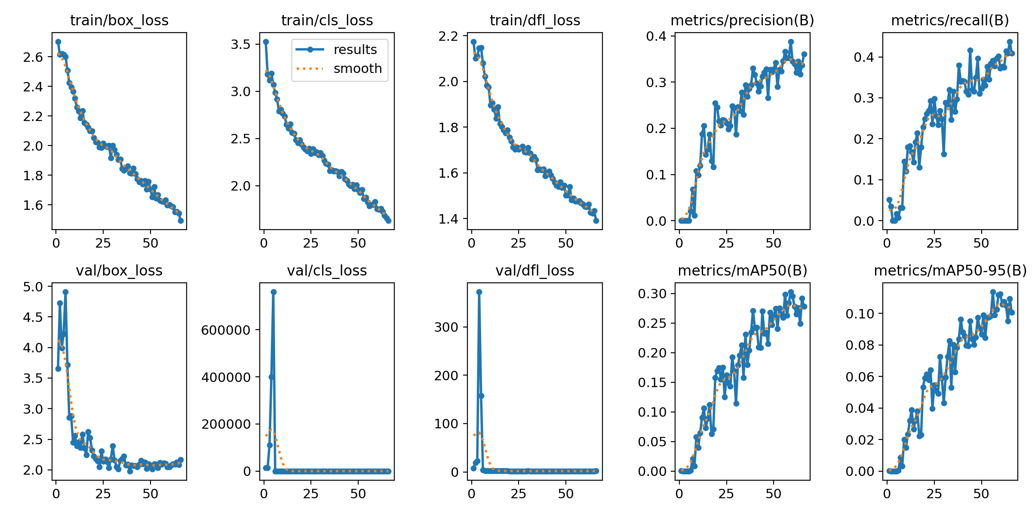
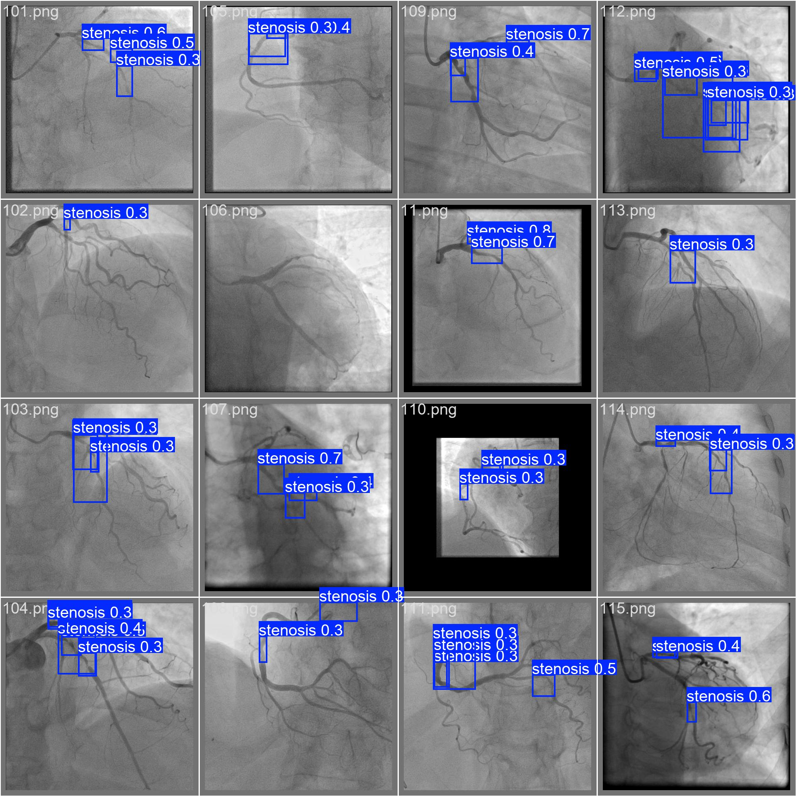

Slide 35
epoch | time | train/box_loss | train/cls_loss | train/dfl_loss | metrics/precision(B) | metrics/recall(B) | metrics/mAP50(B) | metrics/mAP50-95(B) | val/box_loss | val/cls_loss | val/dfl_loss | lr/pg0 | lr/pg1 | lr/pg2
1 | 807.194 | 2.70418 | 3.52753 | 2.17497 | 0.00035 | 0.05172 | 0.00018 | 5E-05 | 3.6555 | 14031.2 | 7.63426 | 0.00062 | 0.00062 | 0.00062
2 | 1605.28 | 2.61664 | 3.18005 | 2.10096 | 0.00024 | 0.03448 | 0.00012 | 3E-05 | 4.72778 | 13664.3 | 19.5648 | 0.00125969 | 0.00125969 | 0.00125969
3 | 2396.23 | 2.62033 | 3.11747 | 2.11115 | 0 | 0 | 0 | 0 | 3.99184 | 110821 | 22.7459 | 0.00189814 | 0.00189814 | 0.00189814
4 | 3181.76 | 2.61713 | 3.18871 | 2.14514 | 0 | 0 | 0 | 0 | 4.22413 | 400728 | 372.503 | 0.00199561 | 0.00199561 | 0.00199561
5 | 3963.05 | 2.60254 | 3.07087 | 2.14826 | 0.00012 | 0.01724 | 6E-05 | 1E-05 | 4.90948 | 760564 | 157.423 | 0.00199219 | 0.00199219 | 0.00199219
6 | 4825.89 | 2.50967 | 2.98685 | 2.08012 | 0.0208 | 0.00739 | 0.00149 | 0.00059 | 3.71506 | 5.44934 | 4.22306 | 0.00198781 | 0.00198781 | 0.00198781
7 | 5705.3 | 2.42327 | 2.91529 | 2.02253 | 0.06831 | 0.03202 | 0.02052 | 0.0085 | 2.85234 | 3.31929 | 2.66374 | 0.00198246 | 0.00198246 | 0.00198246
8 | 6554.03 | 2.39463 | 2.78811 | 1.98298 | 0.01153 | 0.03202 | 0.0088 | 0.00308 | 2.88167 | 3.46107 | 2.56308 | 0.00197616 | 0.00197616 | 0.00197616
9 | 7382.15 | 2.36604 | 2.80878 | 1.97514 | 0.10831 | 0.14532 | 0.05755 | 0.01997 | 2.45101 | 3.20197 | 2.00993 | 0.0019689 | 0.0019689 | 0.0019689
10 | 8169.85 | 2.31905 | 2.76635 | 1.89552 | 0.09855 | 0.12069 | 0.03945 | 0.01477 | 2.558 | 6.1957 | 2.06021 | 0.00196069 | 0.00196069 | 0.00196069
11 | 8948.95 | 2.25769 | 2.73286 | 1.90519 | 0.1186 | 0.1798 | 0.06456 | 0.02345 | 2.3888 | 3.32957 | 1.97408 | 0.00195155 | 0.00195155 | 0.00195155
12 | 9719.53 | 2.23417 | 2.64997 | 1.87749 | 0.18787 | 0.18233 | 0.0907 | 0.03211 | 2.45118 | 2.90106 | 2.02565 | 0.00194147 | 0.00194147 | 0.00194147
13 | 10489 | 2.18742 | 2.60805 | 1.83751 | 0.20534 | 0.16749 | 0.10631 | 0.03885 | 2.36559 | 2.82155 | 1.98379 | 0.00193048 | 0.00193048 | 0.00193048
14 | 11258.9 | 2.23481 | 2.65215 | 1.88838 | 0.14323 | 0.14286 | 0.07303 | 0.02665 | 2.58433 | 2.83104 | 2.31566 | 0.00191858 | 0.00191858 | 0.00191858
15 | 12028.3 | 2.1555 | 2.56214 | 1.81447 | 0.15463 | 0.19193 | 0.08891 | 0.03196 | 2.35503 | 2.81406 | 2.04532 | 0.00190578 | 0.00190578 | 0.00190578
16 | 12804.7 | 2.14199 | 2.5526 | 1.8019 | 0.18665 | 0.21429 | 0.11236 | 0.0381 | 2.24408 | 2.65793 | 1.88518 | 0.0018921 | 0.0018921 | 0.0018921
17 | 13580.8 | 2.12287 | 2.48683 | 1.78735 | 0.12912 | 0.13054 | 0.06252 | 0.02213 | 2.62552 | 3.21568 | 2.10748 | 0.00187754 | 0.00187754 | 0.00187754
18 | 14356.5 | 2.09887 | 2.4528 | 1.7736 | 0.11597 | 0.1798 | 0.07092 | 0.02302 | 2.52747 | 3.10059 | 2.05505 | 0.00186213 | 0.00186213 | 0.00186213
19 | 15126.1 | 2.0981 | 2.48582 | 1.78798 | 0.25496 | 0.22906 | 0.15754 | 0.05337 | 2.32429 | 2.59555 | 1.99202 | 0.00184588 | 0.00184588 | 0.00184588
20 | 15895.1 | 2.05162 | 2.43908 | 1.75509 | 0.24528 | 0.24877 | 0.16945 | 0.0589 | 2.22056 | 2.40108 | 1.83774 | 0.00182881 | 0.00182881 | 0.00182881
21 | 16666.5 | 2.02299 | 2.40799 | 1.73858 | 0.21567 | 0.26108 | 0.1744 | 0.06146 | 2.18241 | 2.44623 | 1.85193 | 0.00181093 | 0.00181093 | 0.00181093
22 | 17437 | 2.02111 | 2.38398 | 1.71159 | 0.20662 | 0.26847 | 0.15491 | 0.05784 | 2.14873 | 2.57099 | 1.85416 | 0.00179225 | 0.00179225 | 0.00179225
23 | 18214.1 | 1.99029 | 2.36458 | 1.7029 | 0.21801 | 0.2931 | 0.17529 | 0.06405 | 2.05102 | 2.52766 | 1.80426 | 0.00177281 | 0.00177281 | 0.00177281
24 | 19011.2 | 1.98508 | 2.39219 | 1.71171 | 0.21616 | 0.23645 | 0.12526 | 0.03973 | 2.30899 | 2.82423 | 1.83399 | 0.00175261 | 0.00175261 | 0.00175261
25 | 19823.9 | 2.01554 | 2.34065 | 1.70201 | 0.21145 | 0.29803 | 0.16211 | 0.05471 | 2.14071 | 2.58457 | 1.85403 | 0.00173168 | 0.00173168 | 0.00173168
37 | 37782 | 1.84498 | 2.15463 | 1.61241 | 0.28554 | 0.29728 | 0.20426 | 0.07837 | 2.0733 | 2.32515 | 1.73347 | 0.00143152 | 0.00143152 | 0.00143152
38 | 38585.5 | 1.8618 | 2.15725 | 1.61544 | 0.29397 | 0.37931 | 0.23442 | 0.08381 | 2.08995 | 2.21973 | 1.76609 | 0.00140318 | 0.00140318 | 0.00140318
39 | 39391.8 | 1.81372 | 2.1497 | 1.58659 | 0.32952 | 0.3399 | 0.27133 | 0.09635 | 1.97987 | 2.16755 | 1.73143 | 0.00137444 | 0.00137444 | 0.00137444
40 | 41125.2 | 1.81156 | 2.10266 | 1.59687 | 0.31607 | 0.34236 | 0.24233 | 0.08808 | 2.07229 | 2.21708 | 1.76754 | 0.00134535 | 0.00134535 | 0.00134535
41 | 41925.6 | 1.84635 | 2.14913 | 1.60743 | 0.29751 | 0.3399 | 0.24249 | 0.0856 | 2.06993 | 2.20918 | 1.7963 | 0.00131593 | 0.00131593 | 0.00131593
42 | 42738.5 | 1.81007 | 2.13043 | 1.5899 | 0.27985 | 0.31527 | 0.2094 | 0.07968 | 2.07097 | 2.24645 | 1.77177 | 0.0012862 | 0.0012862 | 0.0012862
43 | 43519.3 | 1.77353 | 2.06905 | 1.57509 | 0.29122 | 0.30788 | 0.20861 | 0.07932 | 2.04914 | 2.20619 | 1.75294 | 0.0012562 | 0.0012562 | 0.0012562
44 | 44287.2 | 1.75386 | 2.05086 | 1.55779 | 0.31252 | 0.41651 | 0.27049 | 0.09529 | 2.08777 | 2.11576 | 1.75339 | 0.00122596 | 0.00122596 | 0.00122596
45 | 45058.1 | 1.76277 | 2.01865 | 1.54565 | 0.32039 | 0.3202 | 0.23251 | 0.08371 | 2.15507 | 2.30271 | 1.78905 | 0.00119551 | 0.00119551 | 0.00119551
46 | 45832.9 | 1.73968 | 1.99753 | 1.54 | 0.32823 | 0.31527 | 0.23398 | 0.08008 | 2.10026 | 2.23208 | 1.81068 | 0.00116487 | 0.00116487 | 0.00116487
47 | 46607.9 | 1.76258 | 2.01105 | 1.55897 | 0.266 | 0.34901 | 0.21493 | 0.08483 | 2.12226 | 2.22155 | 1.83172 | 0.00113408 | 0.00113408 | 0.00113408
48 | 47380 | 1.70371 | 1.96682 | 1.53579 | 0.32742 | 0.39655 | 0.26807 | 0.09736 | 2.02218 | 2.14355 | 1.73666 | 0.00110317 | 0.00110317 | 0.00110317
49 | 48148.9 | 1.75817 | 2.00637 | 1.54556 | 0.32163 | 0.31034 | 0.24733 | 0.09078 | 2.09518 | 2.25581 | 1.80119 | 0.00107216 | 0.00107216 | 0.00107216
50 | 48916.1 | 1.70334 | 1.95716 | 1.50132 | 0.3279 | 0.32266 | 0.26095 | 0.08682 | 2.07669 | 2.13953 | 1.79332 | 0.0010411 | 0.0010411 | 0.0010411
51 | 49683.4 | 1.65268 | 1.92526 | 1.50205 | 0.34206 | 0.34483 | 0.27429 | 0.09894 | 2.01231 | 2.09742 | 1.72529 | 0.00101 | 0.00101 | 0.00101
52 | 50457.3 | 1.72069 | 1.95961 | 1.53844 | 0.29017 | 0.33005 | 0.24082 | 0.08464 | 2.09841 | 2.27792 | 1.76004 | 0.000978903 | 0.000978903 | 0.000978903
53 | 51234.4 | 1.64352 | 1.86327 | 1.48021 | 0.32746 | 0.37685 | 0.27568 | 0.09741 | 2.09267 | 2.1594 | 1.817 | 0.000947837 | 0.000947837 | 0.000947837
54 | 52011.8 | 1.66635 | 1.87783 | 1.48842 | 0.32368 | 0.34483 | 0.26528 | 0.0976 | 2.03431 | 2.0959 | 1.76777 | 0.000916833 | 0.000916833 | 0.000916833
55 | 52780.6 | 1.62771 | 1.82729 | 1.47617 | 0.34583 | 0.38424 | 0.25902 | 0.09857 | 2.11503 | 2.11266 | 1.85051 | 0.00088592 | 0.00088592 | 0.00088592
56 | 53548 | 1.62415 | 1.78394 | 1.47519 | 0.36575 | 0.39163 | 0.29835 | 0.11367 | 2.08981 | 2.0245 | 1.81014 | 0.00085513 | 0.00085513 | 0.00085513
57 | 54315.7 | 1.62085 | 1.79717 | 1.47648 | 0.35203 | 0.37735 | 0.26291 | 0.0991 | 2.10973 | 2.07792 | 1.85405 | 0.000824492 | 0.000824492 | 0.000824492
58 | 55082.1 | 1.63102 | 1.7968 | 1.46826 | 0.35195 | 0.39655 | 0.28377 | 0.10259 | 2.10718 | 2.05836 | 1.82145 | 0.000794038 | 0.000794038 | 0.000794038
59 | 55849.5 | 1.59752 | 1.82929 | 1.4615 | 0.38791 | 0.40148 | 0.30285 | 0.11167 | 2.04519 | 2.02821 | 1.78281 | 0.000763797 | 0.000763797 | 0.000763797
60 | 56621.6 | 1.60072 | 1.75323 | 1.45367 | 0.34468 | 0.37192 | 0.29571 | 0.11223 | 2.0499 | 2.06773 | 1.77416 | 0.000733799 | 0.000733799 | 0.000733799
61 | 57391.8 | 1.59274 | 1.74747 | 1.45153 | 0.33947 | 0.37685 | 0.27822 | 0.10566 | 2.07655 | 2.04179 | 1.80668 | 0.000704073 | 0.000704073 | 0.000704073
62 | 58163.4 | 1.58631 | 1.75647 | 1.46287 | 0.32088 | 0.37438 | 0.26515 | 0.10747 | 2.09345 | 2.22403 | 1.78088 | 0.000674649 | 0.000674649 | 0.000674649
63 | 58927 | 1.55086 | 1.72372 | 1.4263 | 0.34473 | 0.41379 | 0.27638 | 0.10497 | 2.09208 | 2.04288 | 1.80092 | 0.000645557 | 0.000645557 | 0.000645557
64 | 59690.6 | 1.55394 | 1.68359 | 1.42357 | 0.31718 | 0.40887 | 0.24915 | 0.09505 | 2.12596 | 2.11937 | 1.85345 | 0.000616824 | 0.000616824 | 0.000616824
65 | 60455.8 | 1.54273 | 1.65741 | 1.43455 | 0.33614 | 0.43775 | 0.2917 | 0.1093 | 2.07999 | 1.99559 | 1.82027 | 0.000588479 | 0.000588479 | 0.000588479
66 | 61222.4 | 1.4922 | 1.62944 | 1.39041 | 0.36015 | 0.40887 | 0.27787 | 0.1006 | 2.1687 | 2.07724 | 1.90061 | 0.000560549 | 0.000560549 | 0.000560549

Slide 36
Session 3 Nano

Slide 37
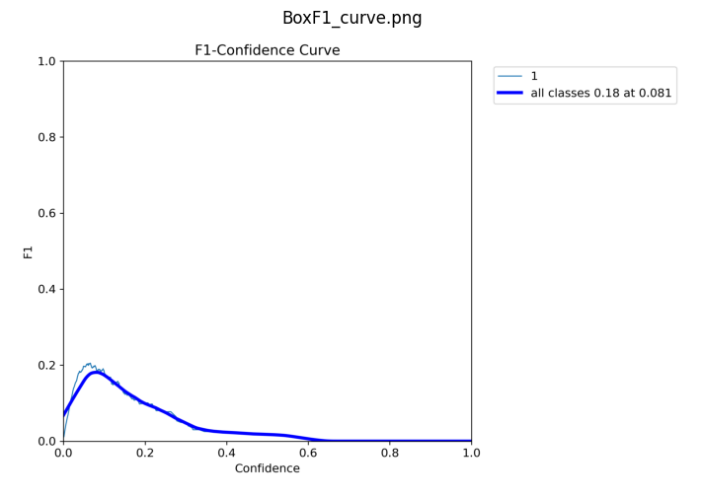



Quick train
# TRAINING_CONFIG = {
# 'model': 'yolov10n.pt', # Nano model (fastest)
# 'epochs': 10, # Quick training
# 'batch': 16, # Good for T4 GPU
# 'imgsz': 640, # Standard resolution
# 'device': 'cuda',
# 'project': 'stenosis_colab',
# 'name': f'fast_training_{datetime.now().strftime("%H%M")}',
# 'patience': 5,
# 'save_period': 2,
# 'verbose': True,
# 'plots': True,
# 'val': True,
# 'cache': True, # Cache for speed
# 'workers': 2,
# 'amp': True # Mixed precision for speed
# }

Slide 38

Quick train

Slide 39




Better training
# MEDICAL_CONFIG = {
# 'model': 'yolov10s.pt', # Small model (better than nano)
# 'epochs': 100, # Much longer training
# 'batch': 8, # Smaller batch for stability
# 'imgsz': 640,
# 'device': 'cuda',
# 'project': 'medical_stenosis',
# 'name': f'medical_training_{datetime.now().strftime("%H%M")}',
# 'patience': 20, # More patience
# 'save_period': 10,
# 'verbose': True,
# 'plots': True,
# 'val': True,
# 'cache': 'disk', # Disk cache for stability
# 'workers': 2,
# 'amp': True,
# 'lr0': 0.001, # Lower learning rate
# 'warmup_epochs': 5,
# 'weight_decay': 0.0005,
# 'cls': 1.0, # Higher classification weight
# 'box': 7.5,
# 'single_cls': False # Keep all classes
# }

Slide 40

Better training

Slide 41




Advanced training

Slide 42

Advanced Training

